Slide 1

2026 IEEE Thompson Okanagan Section AGM
27 March 2026, Okanagan College, Kelowna, BC V1Y 4X8

Slide 2


Slide 3
Agenda
5:00 PM – 5:10 PM – Opening Remarks — online (Dr. Jason Gu, the past IEEE R7 (Canada) president and current IEEE R7 parliamentary representative)
5:10 PM – 5:30 PM – Welcome & Light Supper (Dr. Youry Khmelevsky, TOK Section Chair)
5:30 PM – 5:45 PM – TOK Section Chair’s Report & Welcome
5:45 PM – 5:55 PM – TOK Section Women in Engineering (WiE) Affinity Group Chair’s Report & Welcome — online (Dr. Nisha Puthiyedth)
5:55 PM – 6:05 PM – TOK Section Young Professionals (YP) Affinity Group Chair’s Report & Welcome (Dr. Ghazanfar Latif)
6:05 PM – 6:15 PM – The Value of IEEE Membership and students’ applied research (Kristina Cormier, Ajitesh Parihar and Dolcy Sareen)
6:15 PM – 6:30 PM – Coffee Break & Networking
6:30 PM – 7:00 PM – Annual General Meeting (AGM) Business Session
7:00 PM – 7:15 PM – Roundtable Discussion & Closing Remarks
Notes:
add tom’s picture/headshot

Slide 4

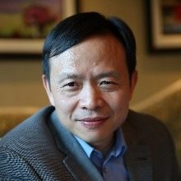
Jason J. Gu, PhD, PEng., FEIC, FCAE
IEEE Canada President-elect, 2018-2019
IEEE Canada President, 2020-2021
Dr Jason Gu is a Full Professor of Electrical and Computer Engineering at Dalhousie University, with a cross-appointment in Biomedical Engineering. A fellow of the Engineering Institute of Canada, the Canadian Academy of Engineering, and the Asia-Pacific Artificial Intelligence Association, he has co-authored over 400 publications and two books.
His research focuses on intelligent robotics, biomedical and rehabilitation engineering, neural networks, and control, and he currently serves as Senior Editor for IEEE Transactions on Automation Science and Engineering.

Slide 5
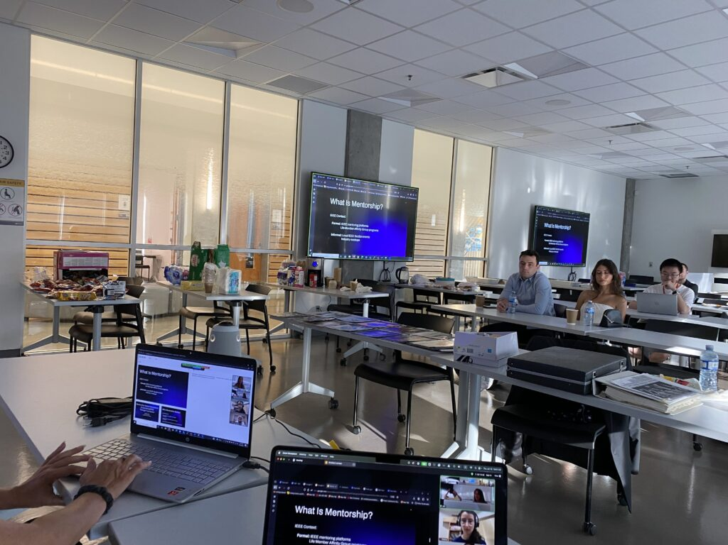
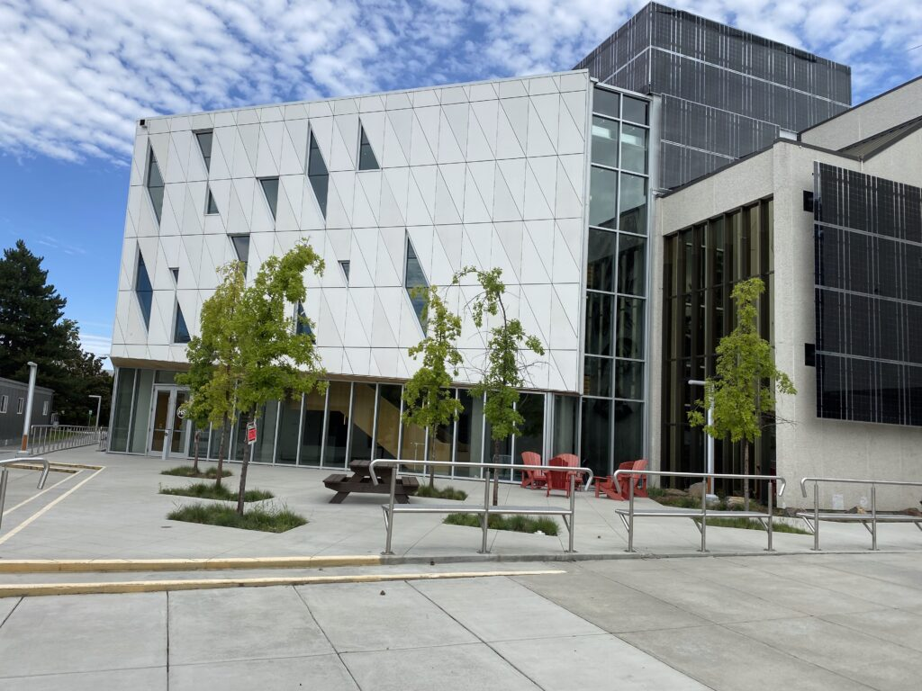
5:10 PM – 5:30 PM – Welcome & Light Supper (Dr. Youry Khmelevsky, TOK Section Chair)

Slide 6
5:30 PM – 5:45 PM – TOK Section Chair’s Report & Welcome History of the Section:
In 2009, Vancouver Section Chair David Michelson polled Okanagan and Northern BC members to determine their interest in forming subsections that would address local interests and concerns and arrange local activities. He led the campaign to gain the required number of signatures on the subsection formation petitions and the petitions to form student branches at UBC-O and UNBC. On 13 February 2010, the IEEE Board of Directors approved forming the Okanagan and Northern BC Subsections.
By 2024, the Okanagan Subsection had grown sufficiently to become an independent section (165 members). Youry Khmelevsky led the effort to gain the required signatures on the section formation petition. On 23 November 2024, the IEEE Board of Directors approved the formation of the new Thompson Okanagan Section.

Slide 7
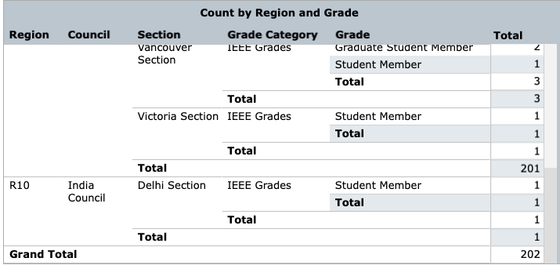
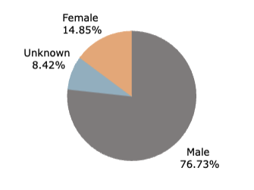
TOK Section Chair’s Report & Welcome (cont.)

Slide 8
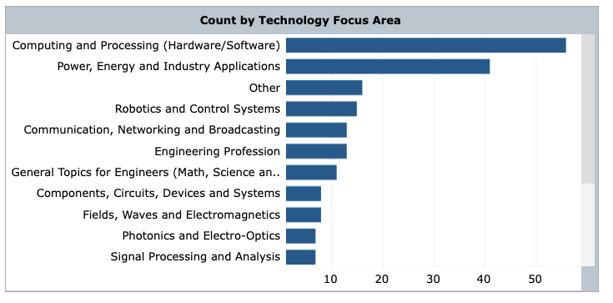
TOK Section Chair’s Report & Welcome (cont.)

Slide 9
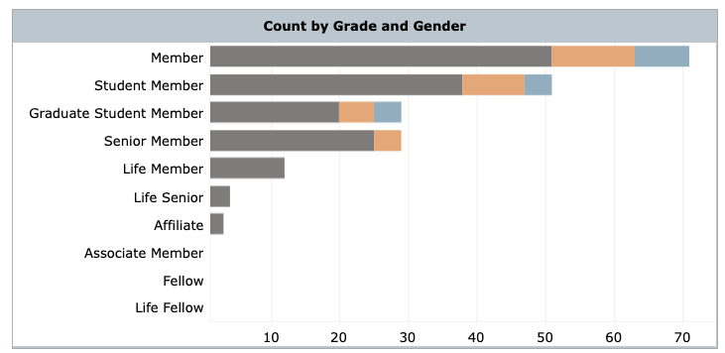
TOK Section Chair’s Report & Welcome (cont.)

Slide 10
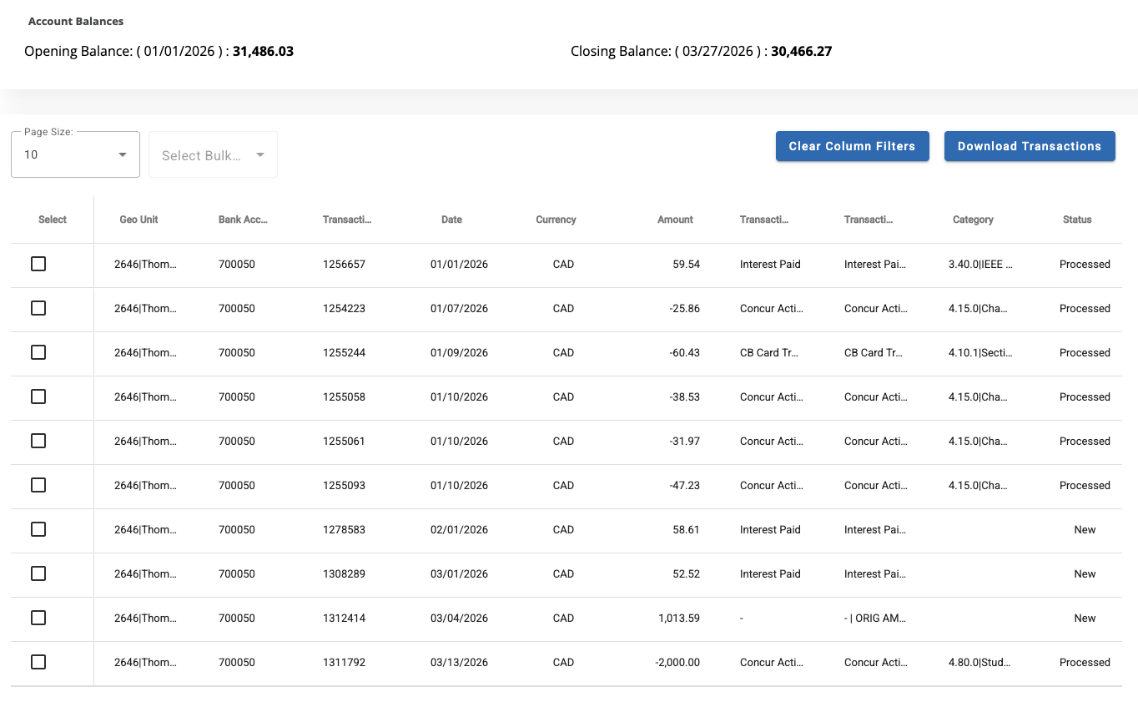
TOK Section Chair’s Report & Welcome (cont.)

Slide 11
TOK Section Chair’s Report & Welcome (cont.) Conferences in Development:
Past workshops and conferences (110 pages report to IEEE BoD in November 2025)
System Council Symposium (OC): August 2026 (Kelowna)
Education Society Symposium (OC): October 2026 (Kelowna)
ANTEM 2027 (MTTSUBCO) — June 2027 (Approved by IEEE Canada)
CCECE 2028 – May 2028 (Approved by IEEE Canada)
Kamloops???

Slide 12
TOK Section Chair’s Report & Welcome (cont.) Petitions in Approved:
04 April 2025: IEEE Thompson Okanagan Section Microwave Theory and Technology Society Chapter — Chair: Vishal Balasubramanian
03 April 2025: IEEE Thompson Okanagan Section Systems Council Chapter — Chair: Youry Khmelevsky, Secretary: Chaoping Guo, Vice Chair: Ghazanfar Latif
Affinity Groups:
05/11/2025: Women in Engineering — Dr. Nisha Puthiyedth, Chair (nputhiyedth[at]tru.ca); Dr. Zeinab Teimoori, Vice Chair (zteimoori[at]tru.ca)
07/25/2025: Consultant Networks.
03/30/2025: Joint Life Members with V. Section — S. Carl Zanon, Chair
2025-05-06: IEEE Thompson Okanagan Section Young Professionals (YP) Affinity Group — Ghazanfar Latif, Chair.

Slide 13
TOK Section Chair’s Report & Welcome (cont.) Student Branches:
STB60099029 - Thompson Rivers University Student Branch
STB05251 - University of British Columbia - Okanagan Student Branch
STB18661 - Okanagan College Student Branch
New SB: Okanagan College Vernon (in process)

Slide 14
TOK Section Chair’s Report & Welcome (cont.) Petitions in Development:
New petitions:
Thompson Okanagan Section Joint Chapter: Submitted on 11/10/2025 03:23:19
MEMCT008 — IEEE Consumer Technology Society (CTSoc, 3 members), MEMCOM019 MEMCOM019 — IEEE Communications Society (13 members) Signatures: 3/12
Chapter/Joint Chapter Thompson Okanagan Section Joint Chapter: Submitted on 11/08/2025
MEMCIS011 — IEEE Computational Intelligence Society (11 members),
MEMIA034 — IEEE Industry Applications Society (21 members) Signatures: 5/12
Thompson Okanagan Section Joint Chapter: Submitted on 11/08/2025 19:34:31
MEMC016 — IEEE Computer Society (13 members),
MEME025 — IEEE Education Society (7 members) Signatures: 6/12

Slide 15
5:30 PM – 5:45 PM – TOK Section Chair’s Report
Executive Officers:
Chair | Youry Khmelevsky (youry at ieee.org)
Secretary | Ghazanfar Latif (glatif at tru.ca); Mohamad Khajezade (MKhajezade at okanagan.bc.ca)
Treasurer | Chaoping Guo (CGuo@okanagan.bc.ca)
Secretary/Treasurer | Matthew Fritter (MFritter at okanagan.bc.ca)

Slide 16
5:30 PM – 5:45 PM – TOK Section Chair’s Report. Committees:
Advertising & Publicity | Vacant
Archivist | Vacant
Awards | Motasem
Communications Officer | Vacant
Conferences | Matthew Fritter & Youry Khmelevsky | MFritter [at] okanagan.bc.ca
Educational Activities | Vacant
History | Vacant
Humanitarian Initiatives | Vacant
IEEE Industry (ICF) Liaison | Youry Khmelevsky | youry [at] ieee.org
Membership | Vacant
Multimedia Team | Vacant
Newsletter Editor | Vacant
Nominations and Appointments | Vacant
Professional Activities | Vacant
Student Activities | Mohamad Khajezade | MKhajezade [at] okanagan.bc.ca
STEM | Vacant
Webmaster | Ajitesh Parihar
IEEE Western Region Student Representative | Kristina Cormier | kristina.cormier [at] myokanagan.bc.ca
Section Liaison of the IEEE Canadian Foundation | Youry Khmelevsky | youry [at] ieee.org

Slide 17
5:30 PM – 5:45 PM – TOK Section Chair’s Report. Election 2026:
TOK Section Election Information:
Technical Chapters and Affinity Groups within the Thompson Okanagan Section will also be conducting elections for their respective officer positions.
Aug 3 – Aug 31: Call for Nominations Period
Sep 14: Initial Slate of Candidates announced
Sep 15 – Oct 19: Petition Period
Nov 9: Final Slate of Candidates announced
Nov 16 – Nov 30: Voting period
Dec 7: Election results announced

Slide 18
5:30 PM – 5:45 PM – TOK Section Chair’s Report. Election 2026:
TOK Section Election Information:
The Thompson Okanagan Section will soon be conducting elections for the section officer positions, including Chair, Treasurer, and Secretary.
Technical Chapters and Affinity Groups within the Thompson Okanagan Section will also be conducting elections for their respective officer positions.
Aug 3 – Aug 31: Call for Nominations Period
Sep 14: Initial Slate of Candidates announced
Sep 15 – Oct 19: Petition Period
Nov 9: Final Slate of Candidates announced
Nov 16 – Nov 30: Voting period
Dec 7: Election results announced

Slide 19

Questions?
Notes:
You can change the background picture

