Slide 1
DRI EDIA Champions Program Project
- Ajitesh Parihar,
Okanagan College
02/20/2025

Slide 2
What is the Digital Research Alliance of Canada?
Notes:
The Digital Research Alliance of Canada is a collaborative initiative aimed at enhancing Canada’s digital research infrastructure. It brings together various universities, research institutions, and government bodies, to create a framework for research support.
They Primarily focus on:
Promoting best practices for managing research data, ensuring that data is stored, shared, and utilized effectively.
Providing equitable access to tools and platforms, helping researchers across the country to leverage advanced technologies.
Foster collaboration among researchers from different disciplines, encouraging interdisciplinary research that can tackle complex societal issues.
The Digital Research Alliance of Canada aims to build a robust digital ecosystem that supports researchers across the nation.

Slide 3
What is Digital Research Infrastructure (DRI)?
Notes:
Digital Research Infrastructure (DRI) refers to the foundational tools, services, and resource that enable researchers to efficiently conduct and collaborate on complex research, particularly in fields where large-scale data, advanced computing, and collaborative platforms are essential.
DRI includes:
Computing Resources
Data Storage & Management
Networking & Collaboration
Software & Applications

Slide 4
Why is DRI Important for Research?
Notes:
Accelerates Innovation:DRI allows researchers to process and analyze large amounts of data quickly, accelerating discovery and innovation.
Enables Complex Research:Facilitates research in cutting-edge areas like genomics, climate modeling, artificial intelligence, and more.
Facilitates Collaboration:Provides a platform for national and international collaboration and enabling shared access to data and tools.

Slide 5
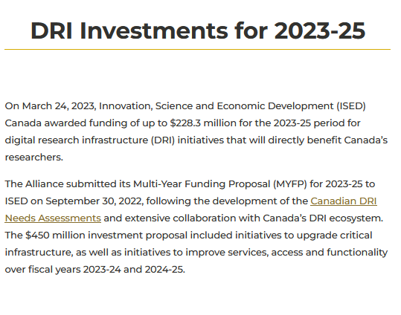
Investments by the Digital Research Alliance of Canada
https://alliancecan.ca/en/initiatives/dri-investments

Slide 6
Key DRI Resources Provided
Computing Resources
Data Storage & Management
Research Software & Tools
Notes:
Computing Resources:
Data Storage & Management:
Research Software & Tools:

Slide 7
Advanced Research Computing (ARC) Services
High-Performance Computing (HPC)
Cloud Computing
Support for Specialized Research
Notes:
High-Performance Computing (HPC):
DRAC provides advanced computing resources to support complex and data-intensive research. HPC clusters allow researchers to solve problems that require large-scale simulations, data analysis, and high computational power.
Cloud Computing:
In addition to on-premise clusters, DRAC offers cloud-based computing resources that provide scalable and flexible computing capacity for research projects. Cloud infrastructure allows for elastic computing, enabling researchers to adjust resources according to the scale of their work.
Support for Specialized Research:
DRAC offers tailored services for specialized research needs such as genomics, machine learning, climate modeling, and artificial intelligence. These areas often require extensive computational resources, which DRAC supports through dedicated infrastructures.

Slide 8
Research Data Management (RDM) Services
Data Storage & Archiving
Data Management Planning
Data Repositories
Notes:
Data Storage & Archiving: secure, scalable data storage solutions. These systems ensure long-term preservation and availability of datasets
Data Management Planning helps promote best practices in data handling, storage, and sharing.
Data Repositories: They provides access to national and discipline-specific data repositories, allowing researchers to deposit, share, and access high-quality data in a standardized format, facilitating FAIR (Findable, Accessible, Interoperable, and Reusable) data principles.

Slide 9
Research Software Services
Access to Specialized Software such as R, MATLAB, Tableau
Support for Open-Source Software
Software as a Service (SaaS)
Training and Support for Software Use
Notes:
Access to Specialized Software
:DRAC provides access to a wide range of software tools tailored to various research needs, from statistical analysis (e.g., R) to simulation tools (e.g., MATLAB) and visualization software (e.g., Tableau).
Support for Open-Source Software:
DRAC encourages the use of open-source software in research, providing access to repositories of free, community-driven tools and supporting customization and development to meet unique research needs.
Software as a Service (SaaS): Through cloud platforms, DRAC enables Software as a Service (SaaS) access, allowing researchers to use research software without the need to install it locally.
Training and Support for Software Use:DRAC offers training and consultation to ensure that researchers can effectively use the software tools available to them. This includes providing help with installation, troubleshooting, and best practices in using research software.

Slide 10
How to access these resources?
Eligibility: Researchers or graduate/postdoctoral students affiliated with Canadian institutions
Visit https://alliancecan.ca/en/our-services
Register at https://ccdb.alliancecan.ca
Notes:
Visit the Alliance’s website → https://alliancecan.ca
Sign up for an account through the CCDB (Compute Canada DataBase) to access the Advance Research Computing Resources
Every registered user gets access to some computational and storage resources without a formal application.
If you need high-performance computing (HPC) or large storage, you must apply through the RAC, which happens annually.

Slide 11
Inclusive Access to Research and DRI
Notes:
The Digital Research Alliance of Canada is actively working to address the challenges of achieving EDIA. We’ve already looked at their DRI and how it can help researchers. Last year, they have also introduced the DRI-EDIA Champions Program: This initiative is designed to empower individuals and institutions to promote and the uptake of DRI resource and open research practices. The program identifies leaders and advocates who can drive change in their respective areas.

Slide 12
Progress Through the Project
Workshop Presentations
RDM and ARC Training
Promoting DRI resources for student research and capstone projects
Open Seeds Program Open-Life-Science training

Slide 13
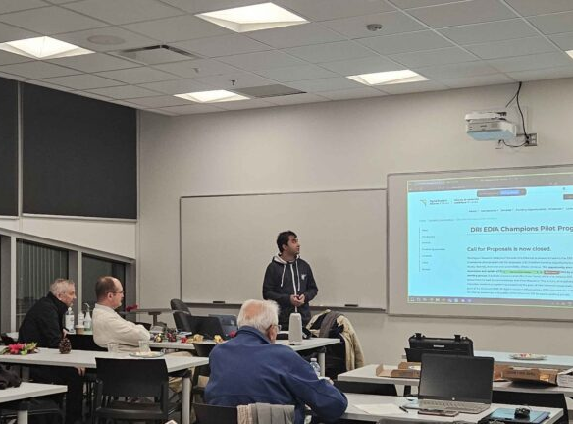
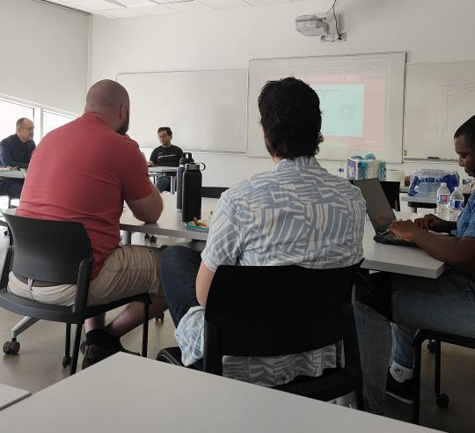
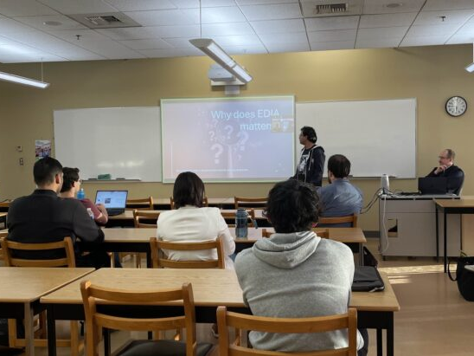
Workshop presentations
April 2024 Cybersecurity Workshop
October 2024 IEEE Day Event
December 2024 Okanagan Section Year End Winter Event
January 2025 DRI Workshop
Notes:
DRI for research requirements presentation at the Cybersecurity Workshop at Okanagan College
Open science and DRA presentation at the IEEE Day Event
Open Science Principle: EDIA Research Discussion about the importance of using open science principles for effective research along with the activities planned for the Digital Research Alliance of Canada’s DRI EDIA Champions Program.

Slide 14
Research Data Management and Advanced Research Computing Training
RDM Training
ARC Training
Notes:
RDM:
- RDM is the process of organizing, storing, preserving, and disseminating research data
A worrying epidemic of irreproducible science, Improtance of RDM
Data Management Planning : Creating a formal document which clearly articulates the strategies and tools your project will use/uses/used and tools you implement to effectively manage your data
The DMP Assistant tool
ARC:
Need for ARC
Use cases: computational fluid dynamics, data science and machine learning
How cluster architecture is different that our computers
Types of accelerators such as GPUs
Accessing remote clusters using ssh and scheduling jobs with slurm
Schedulers and parallelism

Slide 15
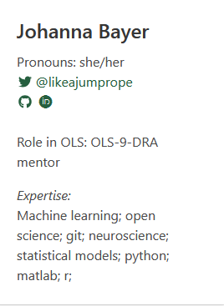
Open Seeds Program by Open-Life-Science
Weekly Cohort and Skill-up sessions.
Mentoring group with 3 researchers.
Feedback for applying opens science principles to our projects.
Notes:
It is a 16-week long mentorship and cohort-based training, where:
share their expertise and gain knowledge essential to create, lead, and sustain an Open Science project
connect with members across different projects, communities, backgrounds, and identities
empower each other to become effective Open Science ambassadors in their communities

Slide 16
Graduation from the Open Seeds Program by OLS
Notes:
Graduated on 1/21,
Training required discussions, activities such as creating an open-canvas, and a final presentation
Learned various this such as open access pulbications/preprints, open data, copyright and licences(MIT, CC), and Inclusive collaboration
Also learned about zenodo and OSF which are great for publishing resources like presentation, as they provide a doi which makes it easier to distribute

Slide 17
The Digital Research Alliance of Canada: DRI
Advanced Research Computing (ARC) Services:
High-Performance Computing (HPC)
Cloud Computing
Support for Specialized Research
Data Storage & Management:
Data Storage & Archiving:
Data Management Planning
Data Repositories
Research Software & Tools:
Access to Specialized Software such as R, MATLAB, Tableau
Support for Open-Source Software
Software as a Service (SaaS)
Training and Support for Software Use
Notes:
The Digital Research Alliance of Canada is a collaborative initiative aimed at enhancing Canada’s digital research infrastructure. It brings together various universities, research institutions, and government bodies, to create a framework for research support.
They Primarily focus on:
Promoting best practices for managing research data, ensuring that data is stored, shared, and utilized effectively.
Providing equitable access to tools and platforms, helping researchers across the country to leverage advanced technologies.
Foster collaboration among researchers from different disciplines, encouraging interdisciplinary research that can tackle complex societal issues.
The Digital Research Alliance of Canada aims to build a robust digital ecosystem that supports researchers across the nation.

Slide 18
Quiz!
Notes:
student researcher from our group is working on cybersecurity education using gamification.

Slide 19
Question 1: What is one of the main responsibilities of the Digital Research Alliance of Canada?
A) Managing social media networks
B) Funding and coordinating Digital Research Infrastructure
C) Selling research software to universities
D) Providing personal cloud storage to students

Slide 20
Question 2: What does the acronym "DRI" stand for?
A) Digital Research Institute
B) Data Resource Initiative
C) Digital Research Infrastructure
D) Distributed Research Information

Slide 21
Question 3: Which of the following is NOT a key component of Digital Research Infrastructure?
A) Advanced Research Computing
B) Research Data Management
C) Internet Browsing
D) Research Software

Slide 22
Question 4: In which regions are resources from the Digital Research Alliance of Canada (DRAC) available?
A) British Columbia
B) Ontario
C) Across Canada
D) Quebec

Slide 23
Question 5: Are DRI tools only available for computer science research?
True
False

Slide 24
Question 6: How can researchers in Canada get access to Digital Research Infrastructure resources?
A) By purchasing a subscription
B) By signing up for a social media group
C) By visiting the Alliance’s website and signing up at the Compute Canada DataBase
D) Researchers cannot access DRI resources

Slide 25
Thank you!
Any Questions?

