Slide 1


Introduction to High Performance Computing (HPC)
- Ajitesh Parihar,
Okanagan College
02/20/2025

Slide 2

Introduction to Advanced Research Computing (ARC)
Speeds up complex simulations and data analysis.
Enables researchers to tackle large-scale problems.
Reduces computational time from months to days/hours.
Notes:
It accelerates the process of discovery;
It maximizes capacity for each project;
It helps even small users achieve high levels of academic and global impact.
My problem takes too long ⟶ more/faster computation
My problem is too big ⟶ more memory
My data is too big ⟶ more storage
Computational Fluid Dynamics
Molecular Dynamics and N-Body Simulations
Smooth Particle Hydrodynamics
Monte Carlo Simulations
Computational Quantum Chemistry
Bioinformatics
Digital Humanities
Data Science and Machine Learning

Slide 3

High-Performance Computing (HPC)
Uses parallel computing to solve complex problems.
Involves clusters of powerful nodes connected via high-speed networks.
Use accelerators like GPUs for massive parallel processing

Slide 4

HPC in Canada: Digital Research Alliance Resources
Cedar, Graham, Narval, Béluga, Niagara – Canada’s HPC clusters.
Supported by Compute Canada & Digital Research Alliance of Canada.
Provides free access to Canadian researchers.

Slide 5
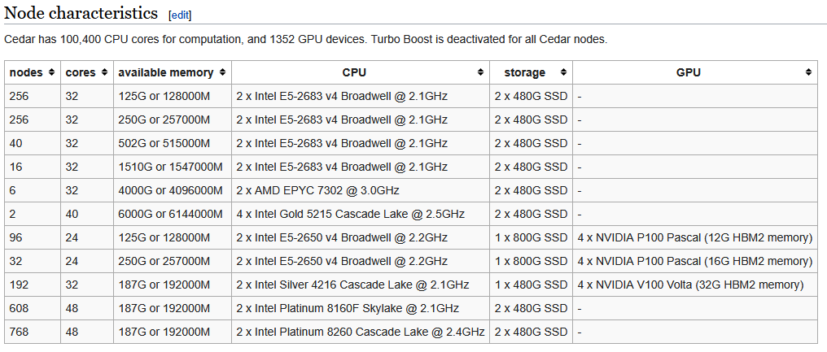
The Ceder Cluster

Slide 6
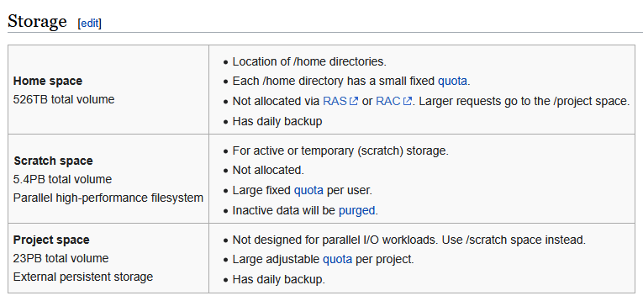
The Ceder Cluster

Slide 7

Knowledge required for using HPC resources
SSH and SCP for remote connection and file transfer
SLURM to schedule jobs

Slide 8
Slurm: The Job Scheduler for HPC Clusters
Command | Description
squeue | View job queue
sbatch | Submit a job script
salloc | Request an interactive session
scancel | Cancel a job
sinfo | View node status
An open-source scheduler that manages jobs on an HPC cluster.
Allocates resources efficiently and queues jobs for execution.
Allows users to request specific resources (CPU, memory, GPUs).

Slide 9

Connecting to the Cluster and Scheduling a Job - Demo

Slide 10

Quiz!
Notes:
student researcher from our group is working on cybersecurity education using gamification.

Slide 11
Question 1:
What does HPC stand for?
A) High-Performance Computing
B) Hyper Parallel Clusters
C) High Power Computing
D) Hybrid Processing Core

Slide 12
Question 2:
Which HPC cluster managed by the Digital Research Alliance of Canada is in BC?
A) Cedar
B) Titan
C) Summit
D) Fugaku

Slide 13
Question 3:
What is the main advantage of using parallel computing in HPC?
A) It reduces computation time by running tasks simultaneously
B) It increases storage capacity
C) It makes debugging easier
D) It replaces the need for a scheduler

Slide 14
Question 4:
What command is used to submit a job to Slurm?
A) squeue
B) sbatch
C) scancel
D) ssh

Slide 15
Question 5:
What command is used to check the status of your Slurm jobs?
A) sbatch
B) sinfo
C) squeue
D) scancel

Slide 16
Thank you!
Any Questions?

