Slide 1
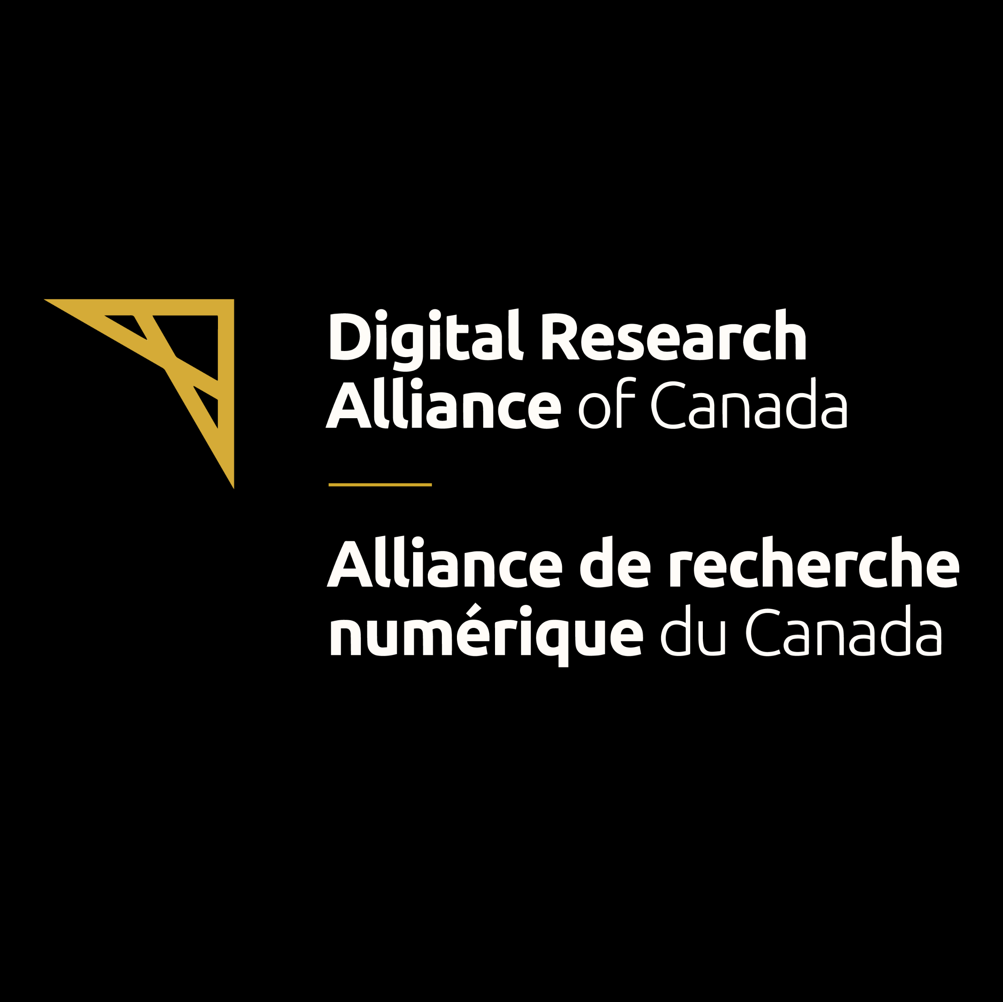
Research Data Management (RDM) Services by the Digital Research Alliance of Canada
- Ajitesh Parihar,
Okanagan College
02/20/2025

Slide 2
What is Research Data Management ?
The practice of organizing, storing, preserving, and sharing research data.
Ensures data integrity, security, and accessibility.
FAIRER Principles: Data should be Findable, Accessible, Interoperable, Reusable, Ethical, and Reproducible.

Slide 3
Research Data Life Cycle
Plan
Collect
Process and Analyze
Store and Preserve
Share and Reuse
Notes:
Plan how to manage, store, and share the data. Identifying which kind of data we need to answer the research question. Create a data management plan. Ethical considerations.
Systematic and standardized data collection while ensuring accuracy, reliability and reproducibility.
Process and Analyze:
Using reproducible workflows to handle and clean data, removing possible errors, duplicates, and inconsistencies from data sets.
Statistical analysis: Use statistical models to perform scientific inference and identify patterns or relationships in the data. Using open source/free software like R or Python is recommended for reproducibility.
Visualization: Creating visualization or plotting model results
Long-term preservation in trusted data repositories. Promote access to your data. Data preservation. Applying appropriate licenses that define how others can use and cite your data.
Repurpose data: Use the data for new research questions or in combination with other datasets.

Slide 4
Why is RDM Important?
Required by funding agencies and institutions.
Prevents data loss and corruption.
Encourages collaboration and reproducibility.
Supports open science and data sharing.

Slide 5
Challenges of RDM
Lack of awareness about RDM requirements.
Managing sensitive or restricted data.
Ensuring data is properly archived and reusable.

Slide 6
What is a Data Management Plan (DMP)?
A formal document which clearly states the strategies and to effectively manage your project’s data.
It includes details about how data will be shared and under what conditions, if any.
They’re a research data management best practice.

Slide 7
Role of the Digital Research Alliance of Canada in RDM
Provides national-scale infrastructure and guidance.
Supports researchers with tools, training, and best practices.
Helps institutions meet federal funding requirements for data management.

Slide 8
Key RDM Services Provided by the Alliance
Provides national-scale infrastructure and guidance.
Supports researchers with tools, training, and best practices.
Helps institutions meet federal funding requirements for data management.

Slide 9
Lunaris – Data Discovery Platform
A metadata search tool that aggregates datasets from multiple sources.
Helps find and reuse existing research data.
Access at: https://www.lunaris.ca
Notes:
Lunaris is a scalable, national research data discovery service provided by the Digital Research Alliance of Canada as one of its core Research Data Management services.

Slide 10
Lunaris Demo
Notes:
Lunaris is a scalable, national research data discovery service provided by the Digital Research Alliance of Canada as one of its core Research Data Management services.

Slide 11
Federated Research Data Repository (FRDR) – Store & Share Data
A national repository for researchers to store, discover, and share datasets.
Handles large datasets and assigns DOIs for citations.
Supports data preservation and access compliance.
Access at: https://www.frdr-dfdr.ca/repo/
Notes:
The FRDR service provides Canadian researchers in any discipline with a robust repository option into which large research datasets can be ingested, curated, processed for preservation, discovered, cited and shared.
Anyone can use FRDR to search for and download data, and Principal Investigators (PIs), or their sponsored designates, may create a FRDR account and deposit data for publication.

Slide 12
Federated Research Data Repository (FRDR) Demo
Notes:
The FRDR service provides Canadian researchers in any discipline with a robust repository option into which large research datasets can be ingested, curated, processed for preservation, discovered, cited and shared.
Anyone can use FRDR to search for and download data, and Principal Investigators (PIs), or their sponsored designates, may create a FRDR account and deposit data for publication.

Slide 13
DMP Assistant – Create a Data Management Plan
A web-based tool that guides researchers in writing Data Management Plans (DMPs).
Helps meet funding requirements and adopt best practices.
Access at: https://dmp-pgd.ca
Notes:
This tool is freely available to all researchers and develops a DMP through a series of key data management questions, supported by best-practice guidance and examples.

Slide 14
DMP Assistant Demo
Notes:
This tool is freely available to all researchers and develops a DMP through a series of key data management questions, supported by best-practice guidance and examples.

Slide 15
Publications (Zenodo) – Open Access for Research Outputs
Zenodo is an open-access repository for publishing research outputs.
Supports datasets, software, reports, and preprints.
Assigns DOIs for proper citation.
Access at: https://zenodo.org/
Notes:
Safe — your research is stored safely for the future in CERN’s Data Centre for as long as CERN exists. The European Organization for Nuclear Research/Conseil européen pour la Recherche Nucléaire
Trusted — built and operated by CERN and OpenAIRE to ensure that everyone can join in Open Science.
Citeable — every upload is assigned a Digital Object Identifier (DOI), to make them citable and trackable.
No waiting time — Uploads are made available online as soon as you hit publish, and your DOI is registered within seconds.
Open or closed — Share e.g. anonymized clinical trial data with only medical professionals via our restricted access mode.
Versioning — Easily update your dataset with our versioning feature.
GitHub integration — Easily preserve your GitHub repository in Zenodo.
Usage statistics — All uploads display standards compliant usage statistics

Slide 16
Zenodo - Demo
Notes:
Safe — your research is stored safely for the future in CERN’s Data Centre for as long as CERN exists. The European Organization for Nuclear Research/Conseil européen pour la Recherche Nucléaire
Trusted — built and operated by CERN and OpenAIRE to ensure that everyone can join in Open Science.
Citeable — every upload is assigned a Digital Object Identifier (DOI), to make them citable and trackable.
No waiting time — Uploads are made available online as soon as you hit publish, and your DOI is registered within seconds.
Open or closed — Share e.g. anonymized clinical trial data with only medical professionals via our restricted access mode.
Versioning — Easily update your dataset with our versioning feature.
GitHub integration — Easily preserve your GitHub repository in Zenodo.
Usage statistics — All uploads display standards compliant usage statistics

Slide 17
Learning & Training – Develop RDM Skills
The Alliance offers workshops, webinars, and self-paced courses on RDM.
Covers topics like metadata standards, FAIR principles, and secure storage.
Access at: https://alliancecan.ca/en/services/research-data-management/learning-and-training/training-resources
Notes:
The Alliance offers a range of training materials – everything from one-page guides to online training modules and videos – that span the research data life cycle. These materials are intended for researchers, library data specialists, research data managers, and discipline and functional experts across the research data landscape. All training resources created by the Alliance are licensed under CC BY-NC 4.0 and are free to share and adapt for your own needs.

Slide 18
Quiz!
Notes:
student researcher from our group is working on cybersecurity education using gamification.

Slide 19
Question 1: What is the main principle behind FAIRER data?
A) Data should be expensive to access
B) Data should be available only to experts
C) Data should not only be Findable, Accessible, Interoperable, and Reusable, but also Ethical and Reproducible
D) Data should be deleted after project completion

Slide 20
Question 2: What is the main goal of Research Data Management (RDM)?
A) To secure research funding
B) To organize, store, and share research data
C) To avoid criticism
D) To publish journal articles

Slide 21
Question 3: Which of the following RDM services helps researchers store and share large datasets?
A) Lunaris
B) DMP Assistant
C) Federated Research Data Repository (FRDR)
D) Zenodo

Slide 22
Question 4: What does Lunaris help researchers do?
A) Create data management plans
B) Discover and search for research datasets
C) Store confidential research data
D) Automate data creation

Slide 23
Question 5: What is the purpose of DMP Assistant?
A) To create a structured data management plan
B) To back up research data
C) To generate citations for datasets
D) To analyze research data

Slide 24
Question 6: Which platform provides open-access publication for research datasets, software, and reports?
A) FRDR
B) DMP Assistant
C) Zenodo
D) None of these

Slide 25
Question 7: Which platform provides open-access publication for research datasets, software, and reports?
A) FRDR
B) DMP Assistant
C) Zenodo
D) None of these

Slide 26
Question 8: A Data Management Plan is crucial for efficient Research Data Management.
A) True
B) False

Slide 27
Thank you!
Any Questions?

