Slide 1
Okanagan College IEEE Student Branch

Slide 2
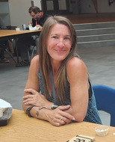
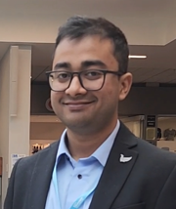
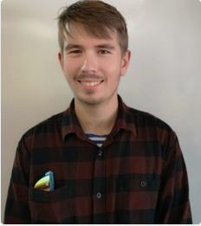
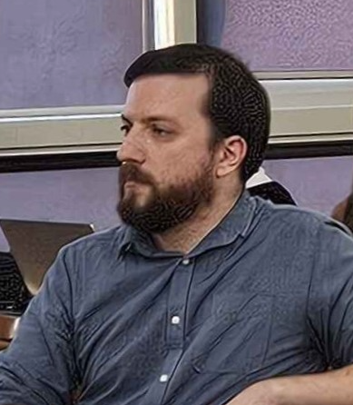
Our board
Chair: Kristina Cormier
Vice Chair: Ajitesh Parihar
Secretary: Alex Ross
Treasurer: Dale Hendricks
Director of Marketing: Dolcy Sareen

Slide 3
Year in review
Previous board members acknowledgement
Thais Santo Damasceno
Daniel Tumback
Alex H
Alex Ross
Kristina Cormier
Lots of events and fun
Many new student members
Elevation of section

Slide 4
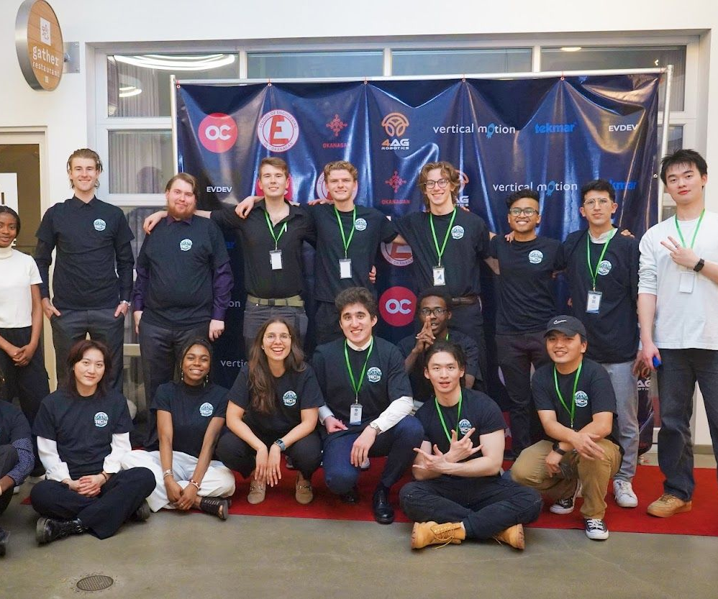
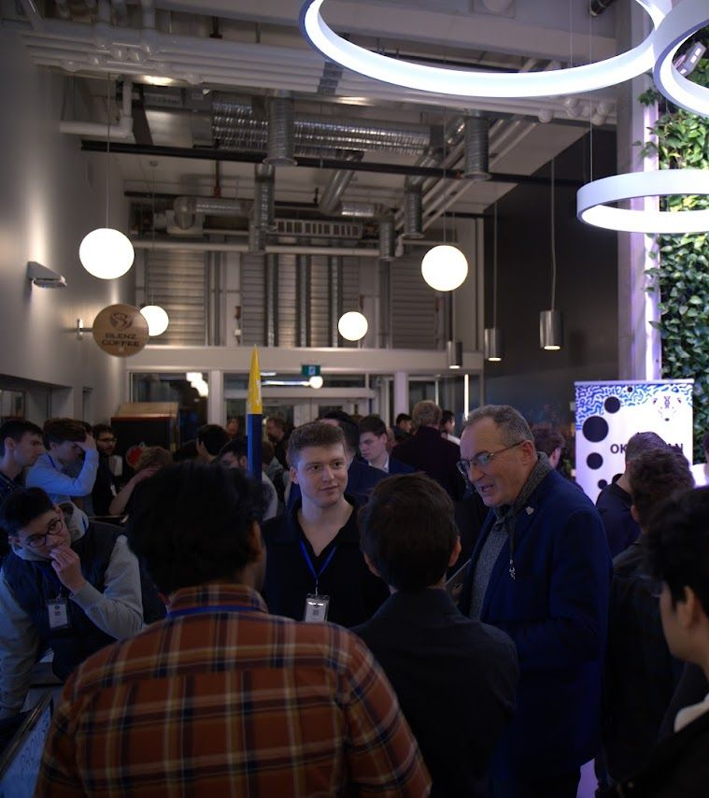
Okanagan Tech Industry Night

Slide 5
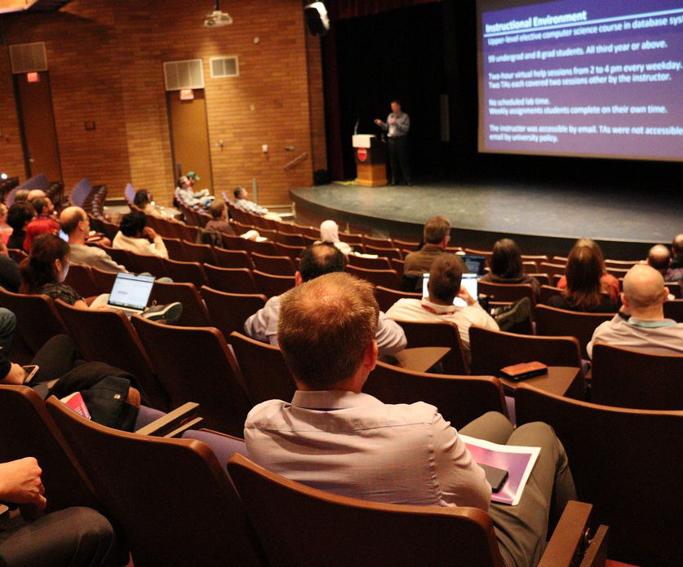
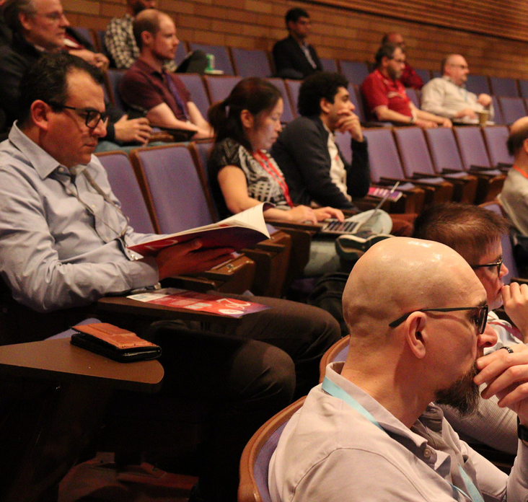
26th Western Canadian Conference on Computing Education

Slide 6
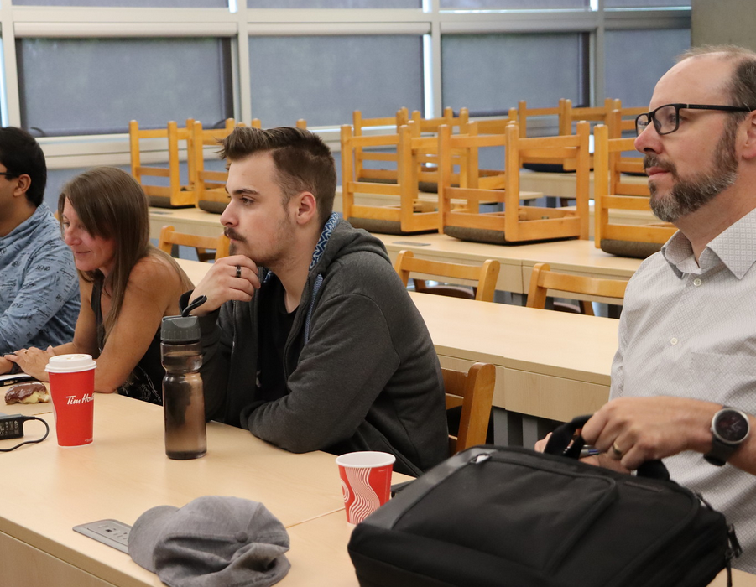
Robotic Process Automation (RPA) and Intelligent Process Automation (IPA) for Small Industries in BC (a mini workshop)

Slide 7
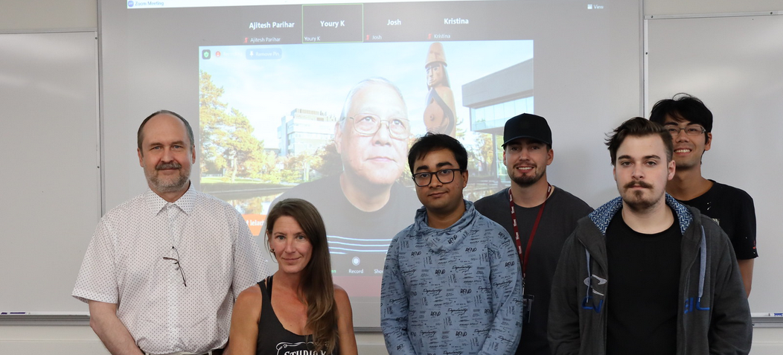
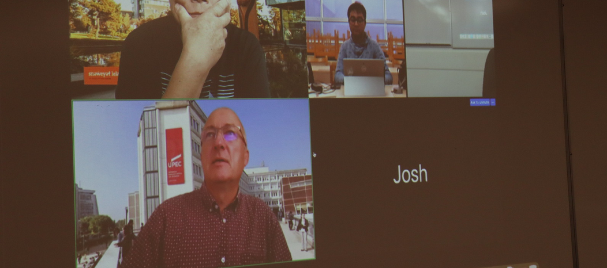
Algorithmic Trading and Short-term Forecast for Financial Time Series with Machine Learning Models Implementation and Testing

Slide 8
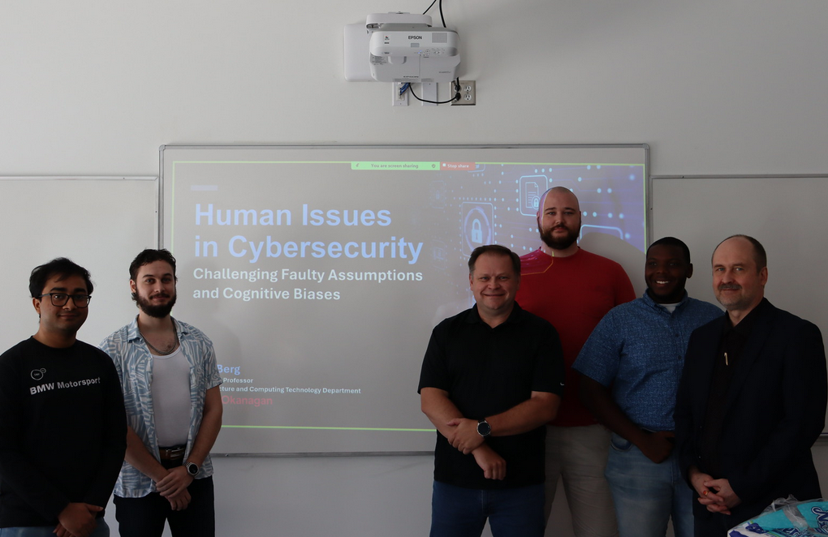
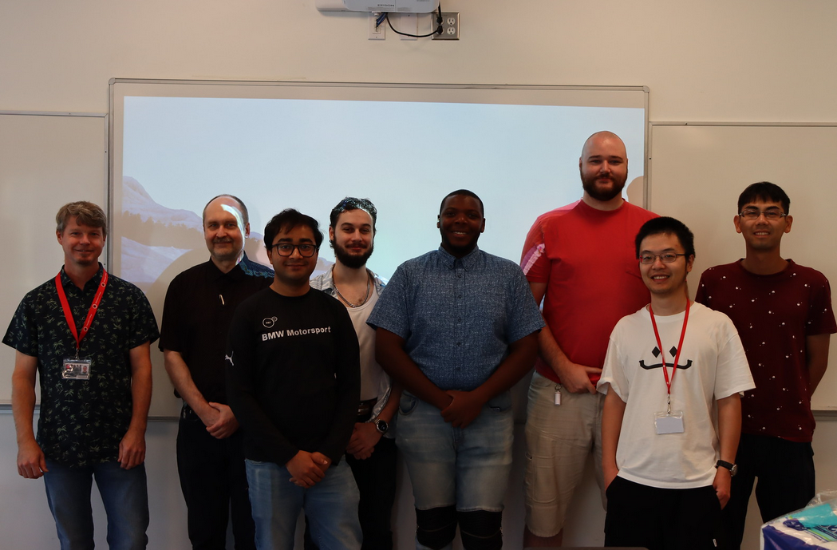
Cybersecurity Workshop at Okanagan College

Slide 9
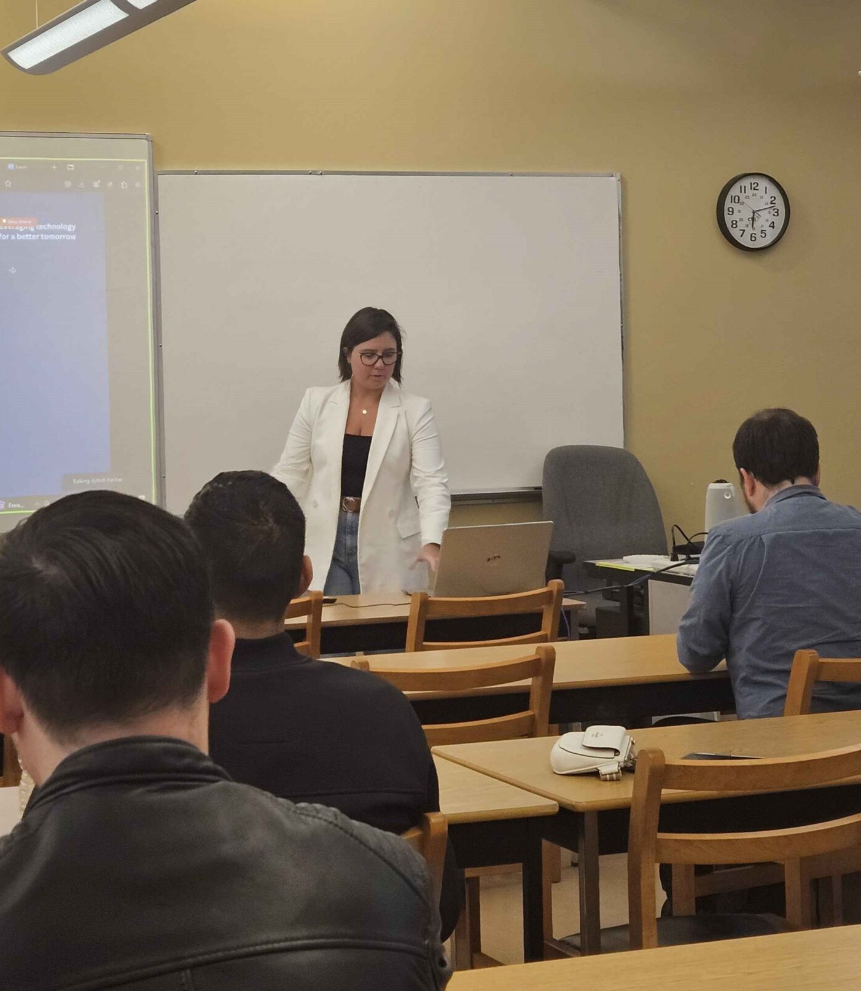
IEEE Day at Okanagan Subsection

Slide 10
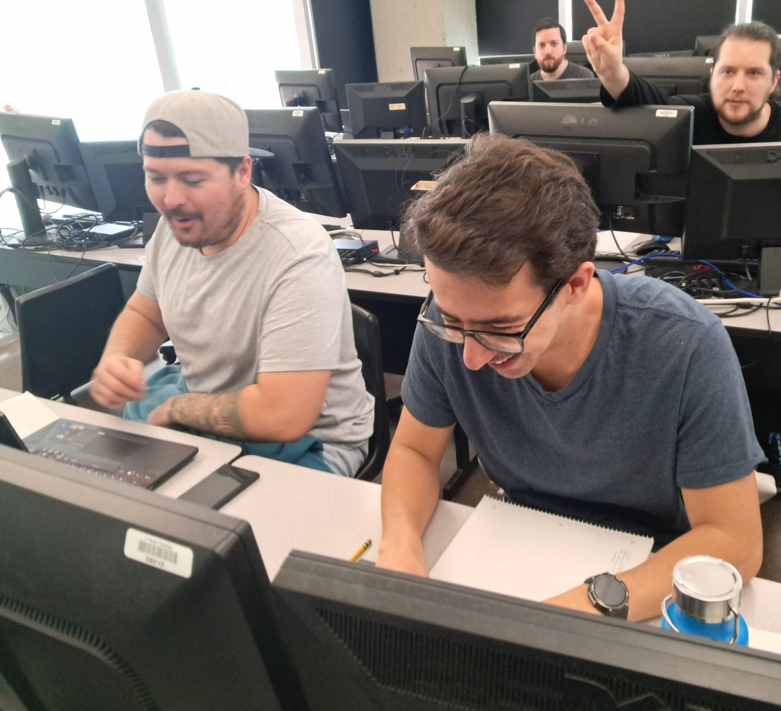
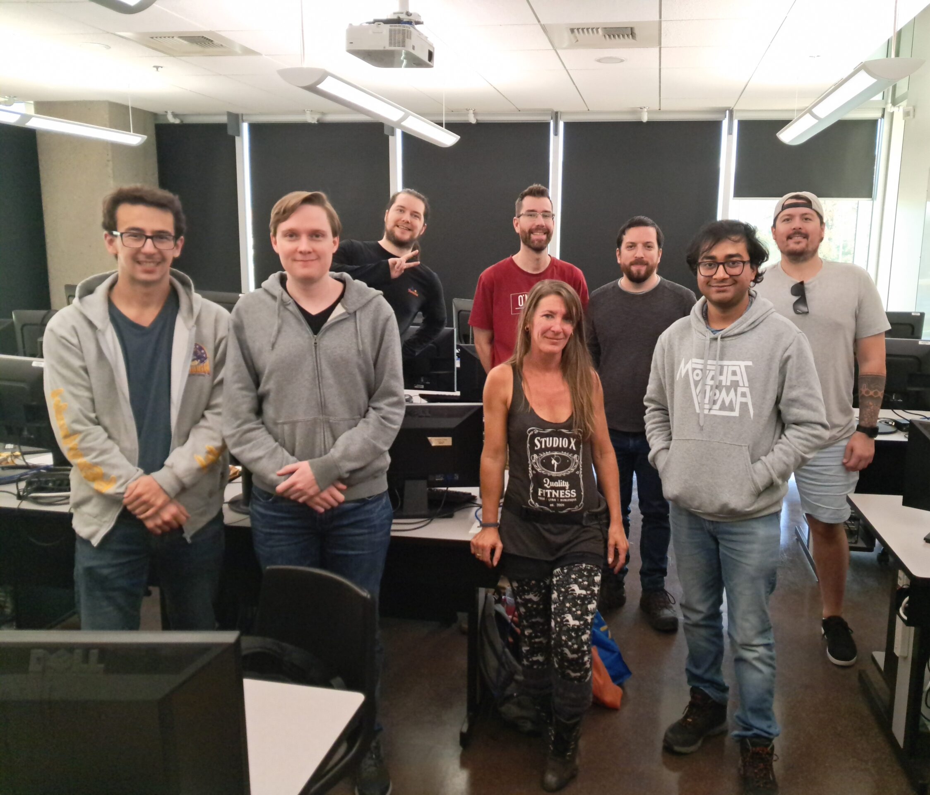
IEEEXtreme 18.0

Slide 11
Upcoming events this new year
Empowering Communities workshop
Cybersecurity mini conference
Mini hackathons
Tech talks
Much more

Slide 12
Thank You!

