Slide 1

Algorithmic Trading System Workshop
Gaétan Hains, Université Paris-Est Créteil
Collaborator to:
Albert Wong, Langara College
Youry Khmelevsky, Okanagan College
Notes:
Outline of our research project 2022- on a renewed application of machine learning to real-time (low frequency) stock-price prediction.
Our goal is to produce an industry-strength innovative system for collecting and analyzing heterogeneous data sources for predicting stock prices at the time scale of minutes.

Slide 2



Workshop Overview
Importance and relevance of machine learning in financial forecasting
Collaborative effort between Okanagan College, Langara College, and UPEC
Notes:
Albert Wong, Langara College (ML)
Youry Khmelevsky, Okanagan College (DB)
Gaétan Hains, U. Paris-Est (HPC)

Slide 3

Practical Applications
Real-world applications of machine learning in financial markets
Potential benefits of using accurate short-term forecasting models
Notes:
Efficient short-term stock-price forecasting can be used by human traders and investors to improve their efficiency and replace decisions that could be taken at a slower pace or less profitably by hand. We do not target high-frequency tarding (tens of ms reactions time) but rather minutes. Objective for our Machine Learning models to be retrained before every inference (prediction): Dr Wong’s talk. This radically improves the quality of our predictions. We use data that is both technical (stock exchange time series) and non-technical: company information and in the future social media opinions.

Slide 4

Previous approaches to Algorithmic Trading and Stock Price Forecasting
Learnings from previous efforts in this field
Notes:
Existing research work and patents demonstrate that the problem we are tackling is relevant, and intensively pursued. Despite a long R&D history of ML in trading, our exact combination of problem and technical solution is today unique: 1. we do not mix trading with stock-price prediction, allowing scientifically-valid tests. 2. we combine heterogeneous data 3. we isolate the best ML models and measure their quality 3. we are able to benchmark and predict prediction speed for large-scale (500 companies) application.

Slide 5
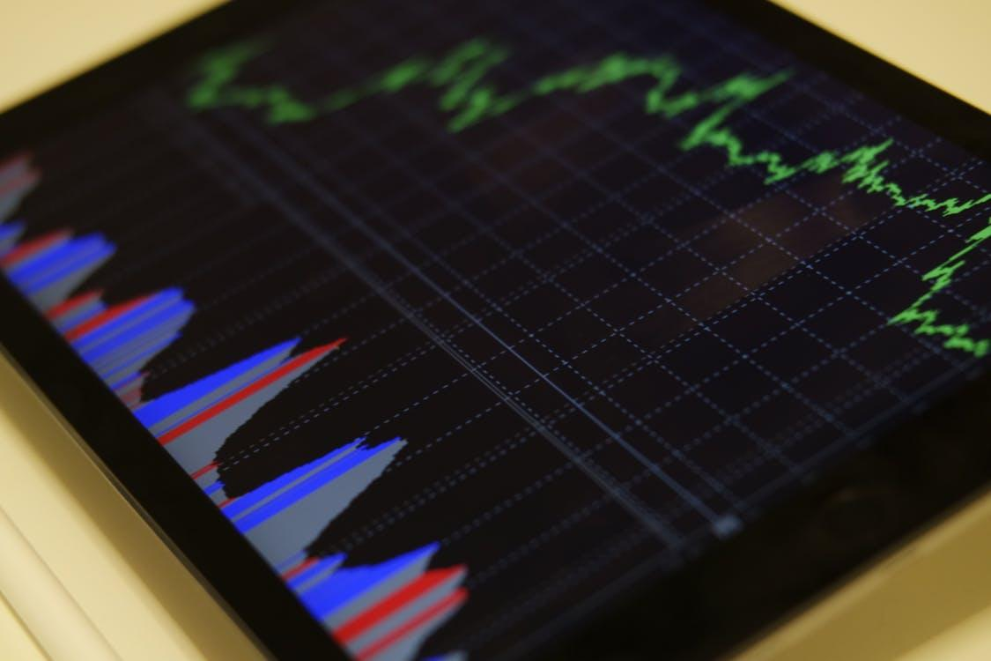
Objectives of the Research Project
Easy to use product for efficient and accurate stock price prediction
Development of the Machine Learning Algorithm at Langara College
Data collection and database development at Okanagan College

Slide 6
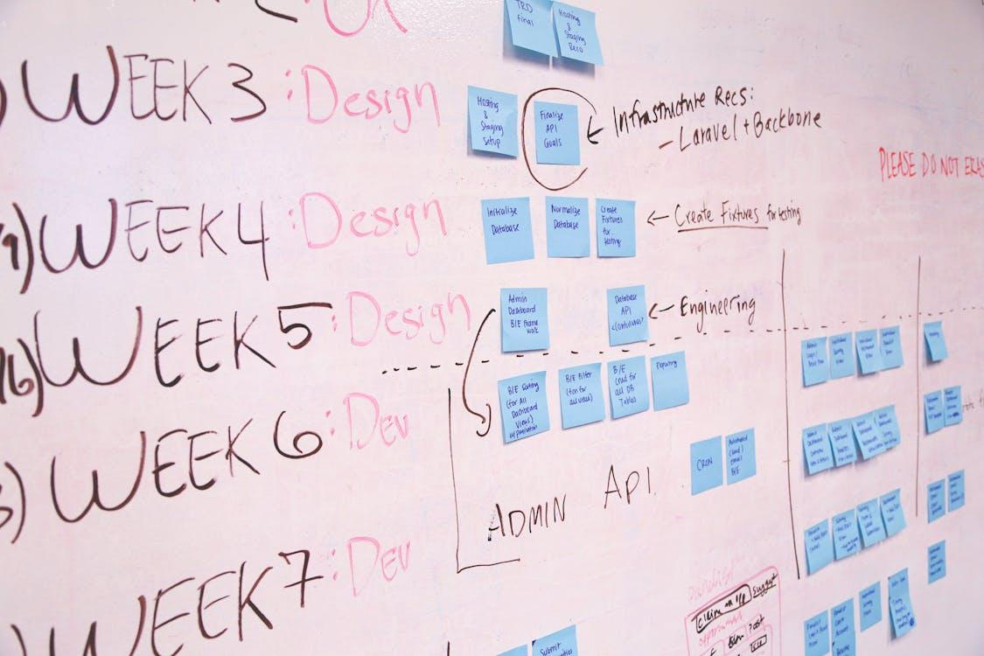
Student Project
Students worked on the project over multiple semesters during their capstone project

Slide 7

Challenges faced over the course of the Project
Challenges encountered during the sub-project:
Software modularity, maintainability
Cloud-hosted database
UI design and implementation
Speed of maintenance and normal operations
TBD: scalability

Slide 8
Storage and Computation Requirements
Data Storage Needs:
Input Data: 18.8 GB for 500 companies (scaled from 150 MB for 4 companies).
Training Data: 120 GB (including 6x time series data).
OLTP Database Storage: 10x the size of flat files = 1.2 TB.
Data Warehouse Storage: 10-100x for denormalization, historical data, indexes, and pre-aggregated data = 12 TB - 120 TB.
Compute Time:
Current MTT: 33,000 seconds for training XGBoost on 4 companies.
Projected for 500 Companies: 48 days of 1 CPU; daily training requires 48 years of CPU time.
Scaling to 5000 Companies: Estimated 50 CPU years needed.
GPU Acceleration: Estimated 20x speedup; reduces time to ~2.5 GPU years.
Target Reduction: Improve MTT from 33,000 seconds to 5-10 seconds, requiring 1000-2000x more resources.

Slide 9

Future Work
Future direction with the project:
- Continue to improve ML models with social-media info and sentiment analysis
- Scale-up and parallelize the training-inference on HPC hardware to maintain speed to real-time.
- Put the data-warehouse system into regular production.

Slide 10

Q & A
Any Questions?
=3

Slide 11
Thank you!

Slide 12

Lessons learned
Solutions implemented to mitigate the challenges

