Slide 1
R
Programming Language
By Daniel Rozek, Aubrey Nickerson, Chris Mazur, Jack Humphrey, Helder Necker, Jesse Ayers
Notes:
Welcome to the programming language R. During these next several slides, we will guide you all into downloading and installing the language along with R Studio onto your computers. While finishing the installation I will introduce the basics of R.

Slide 2
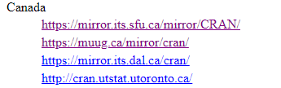
Installing
Open an Internet Browser and go here https://www.r-project.org/
Click the link in red box
Select the first link under Canada.
Select the OS you wish to work R in.
Notes:
Does everyone have a computer up and turned on?

Slide 3
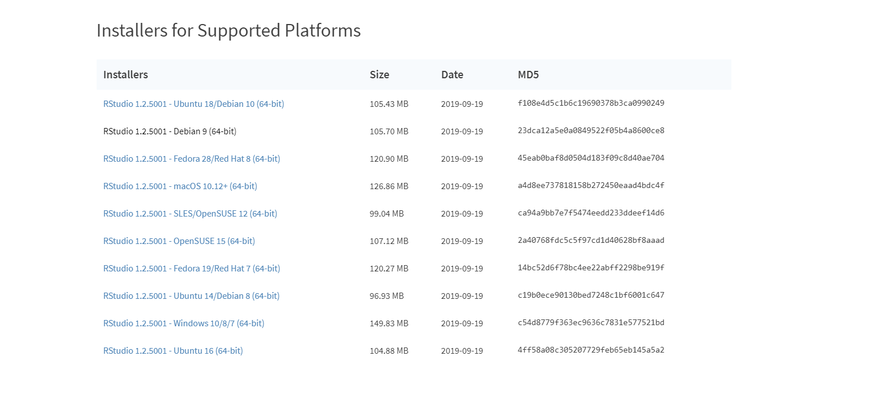
Installing c continued...
Go here https://rstudio.com/ to install RStudio and click Download RStudio
Select the OS you wish to work RStudio in.

Slide 4
Intro to Language
Programming language and free software environment
Used for developing statistical and graphical software and data analysis
It’s a powerful suite of software for data manipulation, calculation and graphical display.
Imperative, Functional, Procedural, Reflective, Array, Object-Oriented
Dynamically typed language
Datatypes in R, Value Examples
Logical/Boolean TRUE, FALSE
Character/String “Name”, “True”, “R”
Numeric/Float 23.5, 4, 653
Integer 5L, 94L, -5L -An ‘L’ claims it an integer.
Complex 2+5i, -3+4x
Raw charToRaw(“Pi”) 50, 69
Notes:
R is a programming language and free software environment which is used for developing statistical and graphical software and data analysis. It’s a powerful suite of software for data manipulation, calculation and graphical display. When classifying the language, following are several of R’s specialties: It’s Imperative, Functional, Procedural, Reflective, Array and Object-Oriented. R is also a dynamically typed language, meaning we can change parts as we are using the program.
Next, below are the names of the datatypes in R along with some examples. Those in bold are what R names its datatypes exactly, meanwhile we might see a second proper name for the top few as well. R’s Logical has only two actual values: true and false, so we might also think about it as booleans. Meanwhile, R’s character can hold single letter character values and also longer strings. The third one, R’s numeric can hold decimal numbers and whole numbers, so a similar datatype from other programming languages is the float. Right underneath is R’s integer, but to claim a number value as an integer it needs to be written with a capital L. The next one is R’s complex which looks similar to saving formulas. The last one is R’s raw which is used for saving bytes of data. The example value turns “Pi” into two bytes, byte 50 and 69.

Slide 5
Basics
Assigning a Variable, 3-Ways, #Comment Symbol
varX = “Value” #Equal operator
varY <- “Value” #Leftward operator
“Value” -> varZ #Rightward operator
Variable’s Datatype
print(class(varX))
[1] “character”
varX = 3
print(class(varX))
[1] “numeric”
To List All Variables
print(ls(all.name = TRUE))
[1] “varX” “varY” “varZ”
rm(varY)
print(ls())
[1] “varX” “varZ”
Notes:
Continuing on about assigning a variable, first to notice, the number sign ‘#’ is the comment symbol in the R language. Now, there are three ways to assign a variable. — <less than >greater
Meanwhile We cannot declare a variable’s datatype, but can ask for the datatype of its value or values. Meanwhile as I said R is dynamical, an example of what I mean, the variables’ datatype can change as it is used during a running program. On the right side is two examples of search and listing the variables. The first one would list all variables that are still available. A variable can be removed and afterwards isn’t available anymore. The second example of listing variables would find and list all except variables that start with a dot.

Slide 6
What is Machine Learning?
Provides software the ability to learn autonomously
Experiences
Observations
Analyzing data within a data set

Slide 7
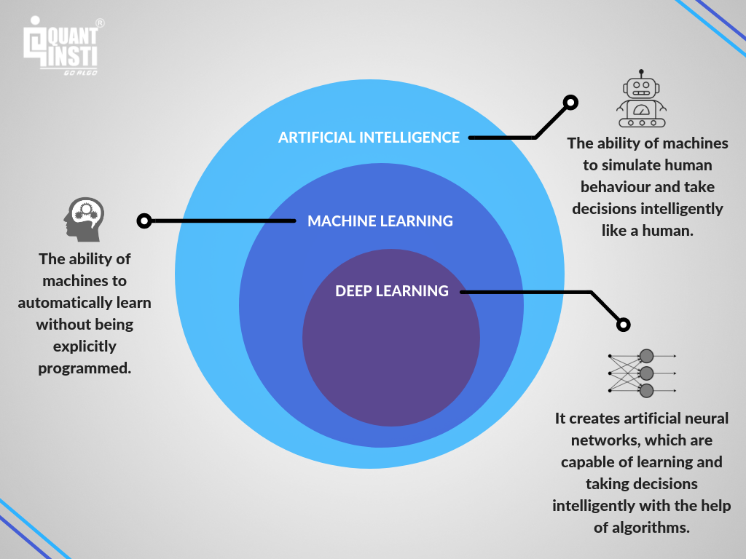

Slide 8
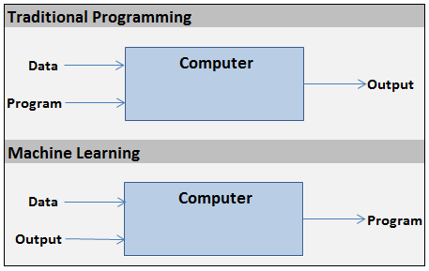
How does it differ from typical programming?
Normally we write an explicit set of instructions.
Machine learning involves giving the machine a set of data and allowing it to make decisions based on its analysis.

Slide 9
Why use Machine Learning?
Easily identify trends and patterns
Automation and continuous improvement
Multi-dimensional data
Many applications
Video: How Machines Learn by CGP Grey
https://www.youtube.com/watch?v=R9OHn5ZF4Uo

Slide 10
Supervised Learning: Teachers, Builders, and Programmers
Uses labeled data!
Teachers - Can’t really “teach,” but can test!
Builders - Creates bots based on best results and modifies, discards bots with worse results.
Programmers - Can observe outcomes, but may not truly understand the function under the surface.

Slide 11
Predictive Modeling
Aspect of Supervised Learning
What is it? Developing a model with historical data to make predictions on new data.
Generally divided into Classification and Regression models.
Typical output of a Classification model: Classes, ie. animal recognition in image.
Typical output of a Regression model: Real numbers, ie. predict prices given some input.
Qualitative vs Quantitative

Slide 12
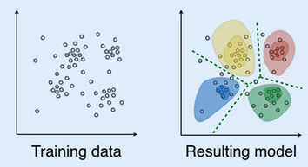
Unsupervised Learning
Data in training set is not labeled
Without labels, accuracy is not an analyzed metric
May discover information that is not/less visible to a human observer
Aim is to find results such as clusters, groups, density

Slide 13
Bias and Variance
Bias is simplifying assumptions made by the model to make function easier to learn.
Variance is the amount that the function’s estimate will change depending on the training data used.

Slide 14
Bias and Variance

Slide 15
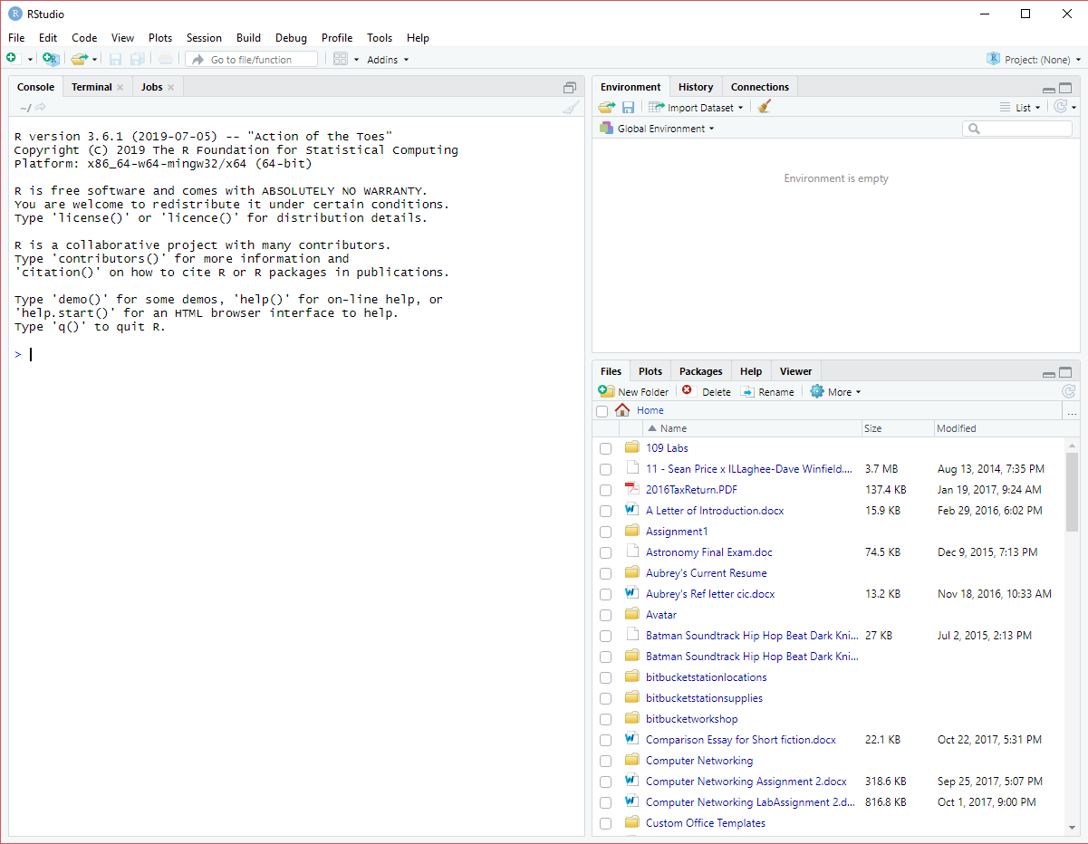
Introduction to RStudio
Your workstation should look similar to this after you installed RStudio
Notes:
Aubreys Speaker Notes: RStudio is an (IDE) for R, a programming language for statistical computing and graphics. As soon as you create a new script, the windows within your RStudio session adjust automatically so you can see both your script and the results in your console when you run your syntax. RStudio is designed to make it easy to write scripts, RStudio makes it convenient to view and interact with the objects stored in your environment, RStudio makes it easy to set your working directory and access files on your computer, If you are working in Windows, one of the most tedious parts of programming in R is setting your working directory to access your files.With RStudio, you can navigate to folders on your computer in the “Files” window, view any files you have in that folder, and set that folder as the working directory. RStudio makes graphics much more accessible for a casual user. You can easily click back and forth between plots, change the sizes of your plot without rerunning the code, and export or copy plots to include in other documents.
While it doesn’t have quite the flexibility of R’s graphical devices, it provides everything that many users would need.

Slide 16
Importing Data to RStudio
https://www.kaggle.com/
In the Search bar at the top, search for Starcraft II Replay Analysis
Notes:
Aubrey’s Speaker Notes: (Ask if everyone has Microsoft Excel) I want everyone to go to this link. We will be grabbing a data set from Kaggle to import on RStudio. Kaggle allows users to find and publish data sets, explore and build models in a web-based data-science environment, work with other data scientists and machine learning engineers. So in the Search Bar at the top, search for StarCraft II Replay Analysis. Before you click the download button, you have to create an account. Its 100% free and quick to sign up. You can delete the account after if you like. After you created the account you can download the file.

Slide 17
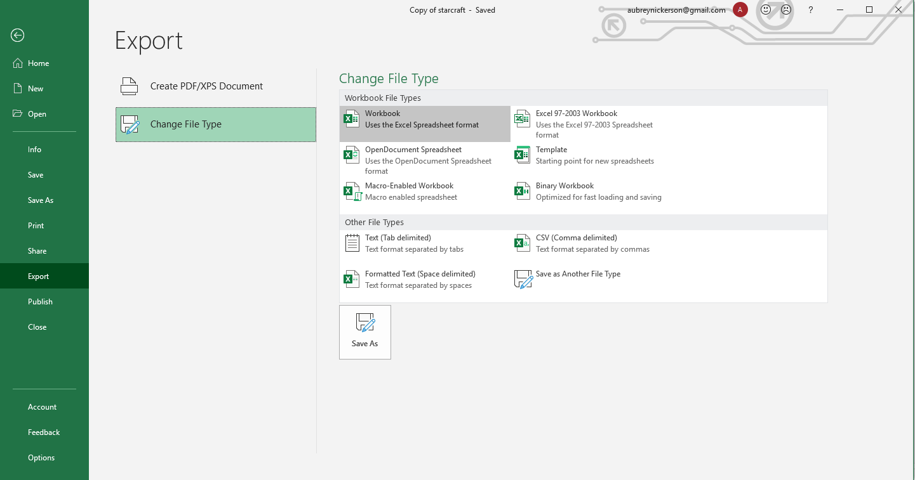
Importing Data to RStudio
Go to file and export to change the file type.
RStudio is not able to work with CSV Excel files.
Notes:
Open Microsoft Excel and open the file you downloaded from Kaggle. Keep in mind that RStudio will not accept Excel CSV files. We will have to convert the file to XLSX. To do this we have to go to the file on the top left and select Export. On the Export section choose Workbook and Save As. Save the file where you can remeber on your file explorer.

Slide 18
Importing Data to RStudio (Alternative way)
If you do not have Microsoft Excel then go to the link below
https://github.com/humbleguidant/RWorkshop

Slide 19
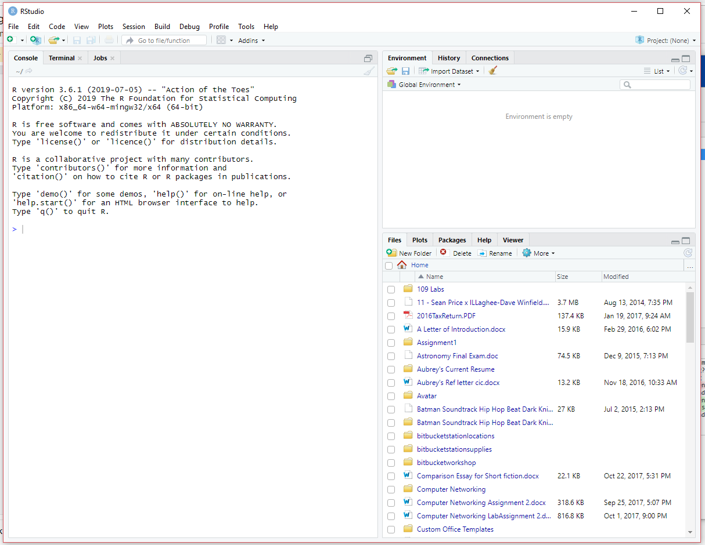
Importing Data to RStudio
Click the Import Dataset button.
Notes:
Now that we have the file downloaded and saved. We can import the file to RStudio. So I want everyone to go on the Environments tab on the right and select the Import Dataset button. This is where you go to import files.

Slide 20
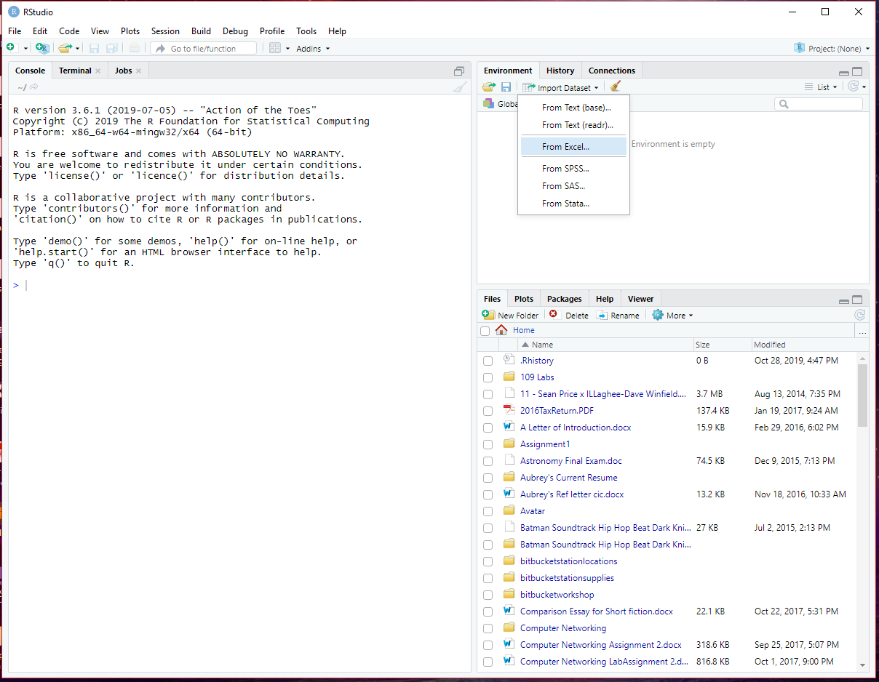
Importing Data to RStudio
For this workshop we will be importing data from an Excel sheet.
Select From Excel
Excel file must be saved as XLS or XLSX
Notes:
Since we will be using an Excel sheet select From Excel.

Slide 21
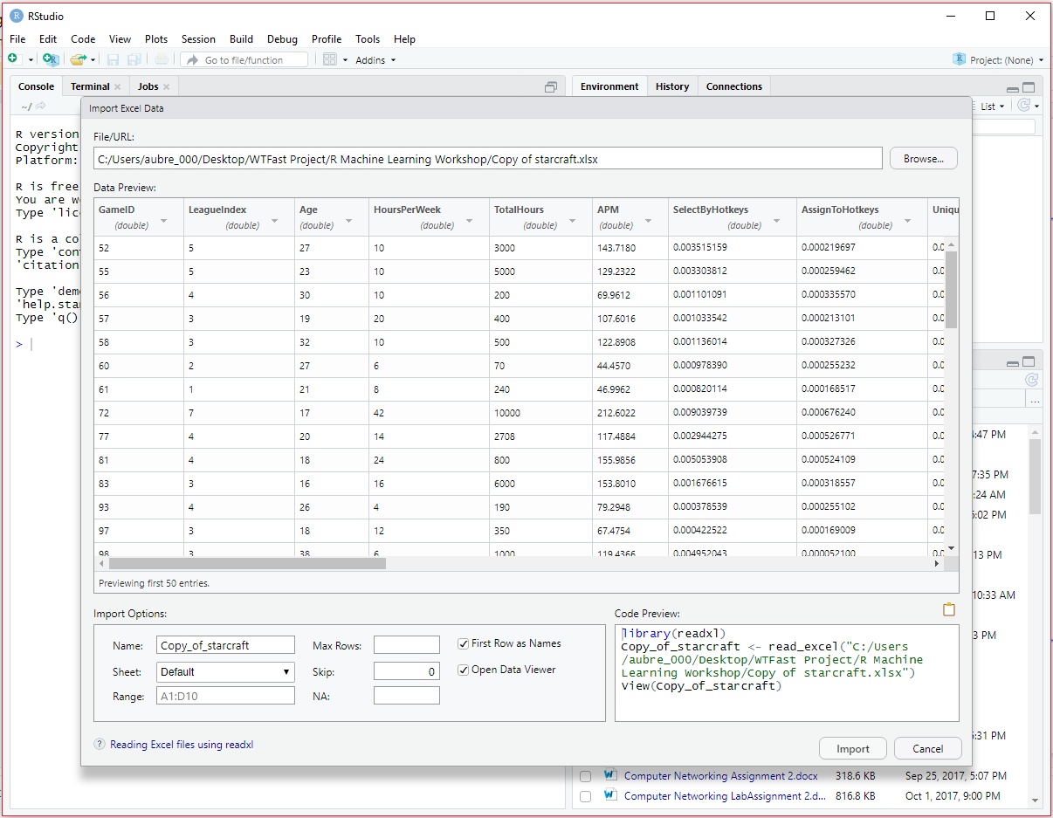
Importing Data to RStudio

Slide 22
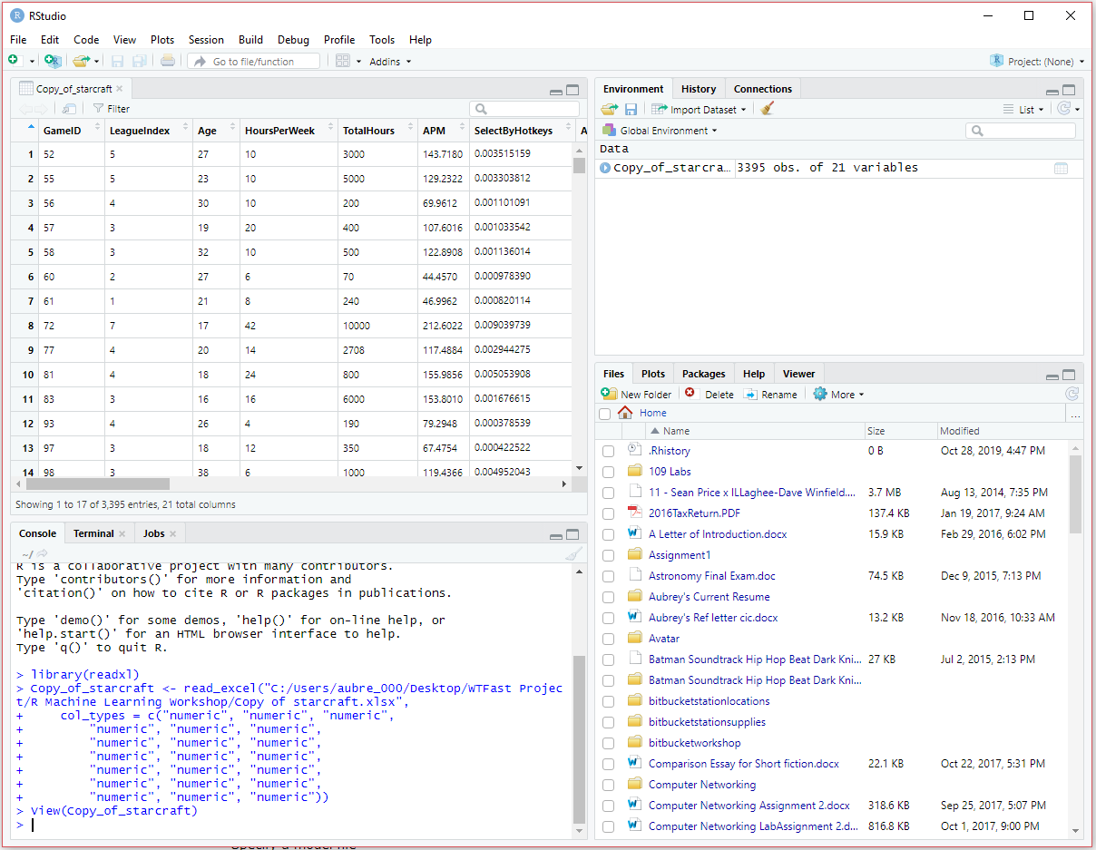
Importing Data to RStudio

Slide 23
Transforming Data in RStudio
There are many ways to manipulate data in R.
Like SQL, you can perform queries such as accessing a particular column in the table, comparing data, and many more.
To access all the data in a particular column of a table, this would be the syntax name_of_table$name_of_column
For example, if we want to gather all the data in the GameID column, the command to perform that query would be Copy_of_starcraft$GameID

Slide 24
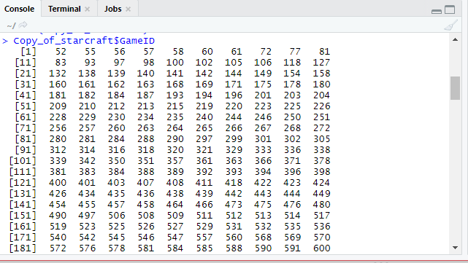
Transforming Data in RStudio
The results would look like this
The query does not display all the data because there is a max limit in displaying data. The query will say it omitted 2,395 entries at the bottom.
To change the max limit use this command: options(max.print = 1000000) then try running the Copy_of_starcraft$GameID command again.

Slide 25
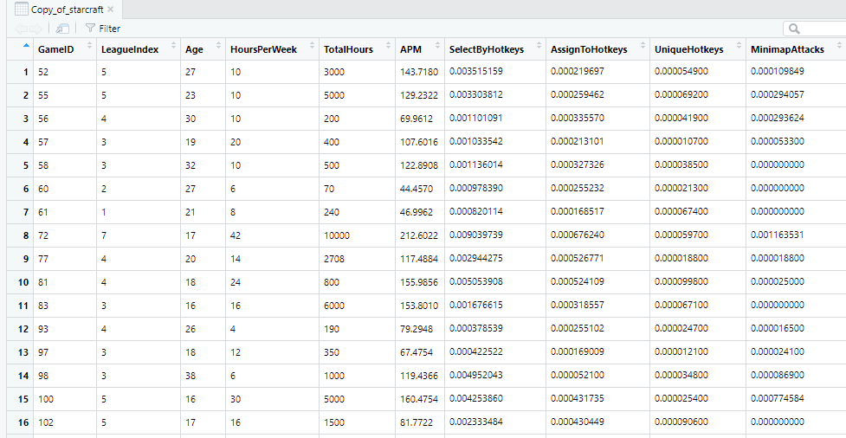
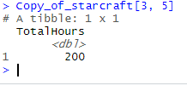
Accessing Data as Vectors
You can access a particular column in a particular row. The syntax looks like this: name_of_table[rowNumberN, columnNumberN]
Let's say we want to access the value of the 5th column in the 3rd row.
The query would return 200 because that's the value in the 5th column of the 3rd row

Slide 26
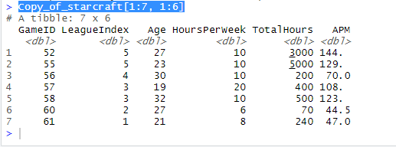
Accessing Data as Vectors
You can access the first 7 rows and the first 6 columns by adding this command: Copy_of_starcraft[1:7, 1:6] and will return:

Slide 27
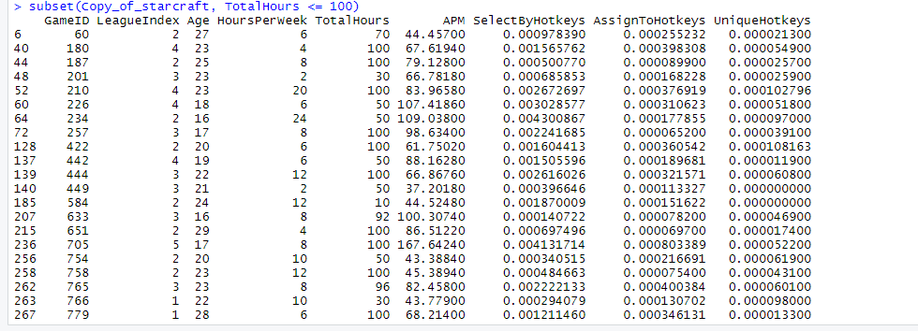
Accessing Data in RStudio
Let’s say we want all the rows where the total hours is less than or equal to 100.
We will need to use the subset() function, for example: subset(Copy_of_starcraft, TotalHours <= 100) will return:

Slide 28
Getting Statistical Averages from Data
RStudio has built in functions to calculate the averages of the dataset
For mean of any column, run: mean(name_of_table$column_name)
Median, run: median(name_of_table$column_name)
Quantile, run: quantile(name_of_table$column_name)
Variance, run: var(name_of_table$column_name)
Standard Deviation, run: sd(name_of_table$column_name)
Try these commands with the Starcraft data.

Slide 29
Other useful functions in RStudio
head(Copy_of_starcraft) - Displays first handful of rows of the Starcraft data set.
dim(Copy_of_starcraft) - tells you the dimensions of the data frame.
names(Copy_of_starcraft) - Gets the names of all the columns associated with the Starcraft data set.
str(Copy_of_starcraft) - Gets the structure of each column from the Starcraft data set.
summary(Copy_of_starcraft) - Gets a quick summary of each column that shows minimum, maximum, missing values, and the stuff in between.

Slide 30
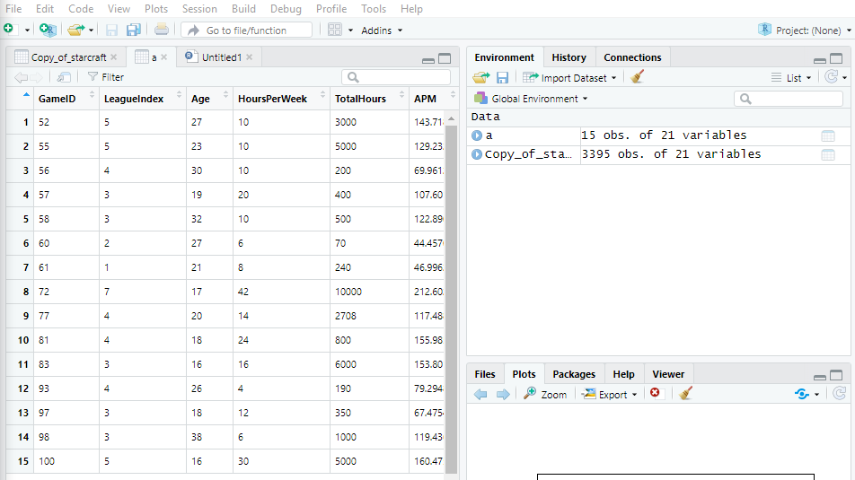
Creating separate tables
You can create a separate table from your data set by assigning a variable to it.
If we want a separate table of all the players with ID numbers between 1 - 100 we can do this command: a <- subset(Copy_of_starcraft, GameID <= 100)
This creates a variable called ‘a’ which is assigning the data of all the players with an ID between 1 and 100.

Slide 31
Plotting Data
A convenient feature of R Studio is it’s built in data visualizer for R. Any data set imported in R can be visualized using the plot and several other functions of R.
For example, to create a scatter plot of a data set, you can run the following command: plot(x = name_of_table$column_one, y = name_of_table$column_two, type = ‘p’)
Type ‘p’ sets the plot type as point. You can also choose line as ‘l’ and many other type variables.

Slide 32
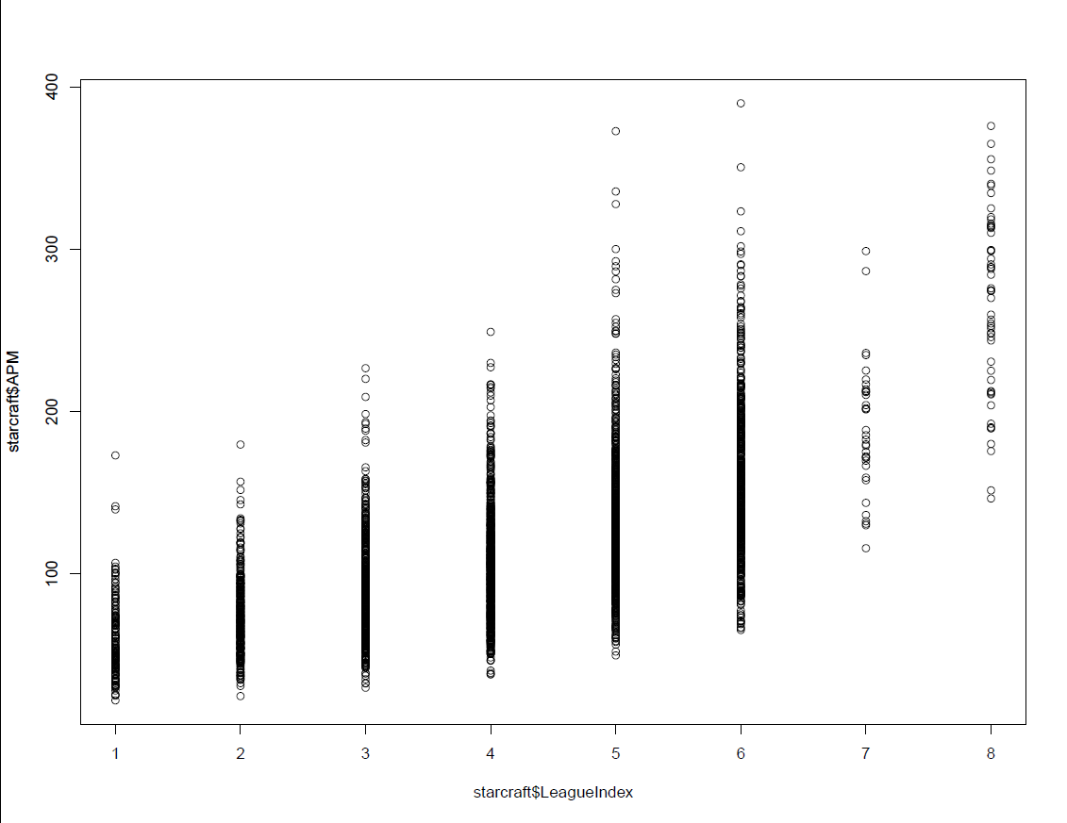
For plotting of R objects - plot()
plot(x = Copy_of_starcraft$LeagueIndex, y = Copy_of_starcraft$APM)

Slide 33
To fit linear models - lm()
lm(Copy_of_starcraft$APM ~ Copy_of_starcraft$LeagueIndex)
Returns the Intercept and the Slope, that we use to plot the regression line using:
abline(22.18, 22.67)

Slide 34
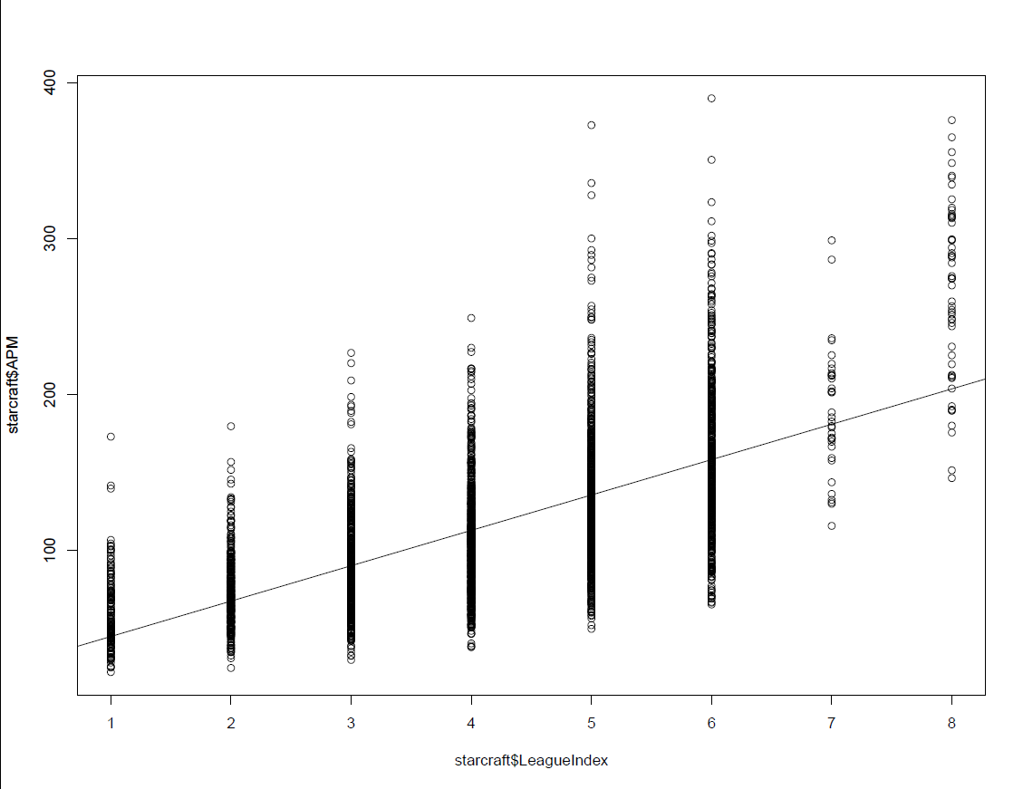
To add regression lines to a graph - abline()
abline(lm(Copy_of_starcraft$APM ~ Copy_of_starcraft$LeagueIndex))

Slide 35
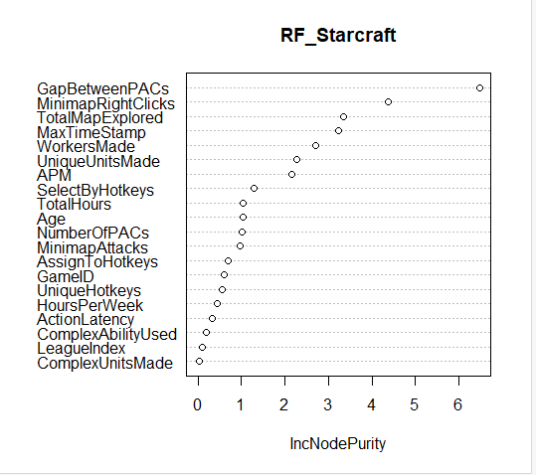
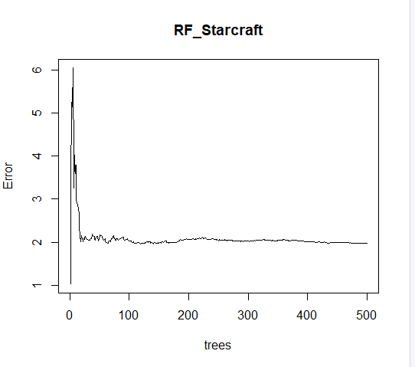
Applying Algorithms in RStudio (Random Forest)
Notes:
Random forest is a statistical algorithm that is used to cluster points of data in functional groups. When the data set is large and/or there are many variables it becomes difficult to cluster the data because not all variables can be taken into account, therefore the algorithm can also give a certain chance that a data point belongs in a certain group.Random Forest is one such very powerful ensembling machine learning algorithm which works by creating multiple decision trees and then combining the output generated by each of the decision trees. Decision tree is a classification model which works on the concept of information gain at every node. For all the data points, decision tree will try to classify data points at each of the nodes and check for information gain at each node. -The first parameter specifies our formula: Species ~ . (we want to predict Species using each of the remaining columns of data).
–ntree defines the number of trees to be generated. It is typical to test a range of values for this parameter (i.e. 100,200,300,400,500) and choose the one that minimises the OOB estimate of error rate.
–mtry is the number of features used in the construction of each tree. These features are selected at random, which is where the “random” in “random forests” comes from. The default value for this parameter, when performing classification, is sqrt(number of features).
–importance enables the algorithm to calculate variable importance.

Slide 36
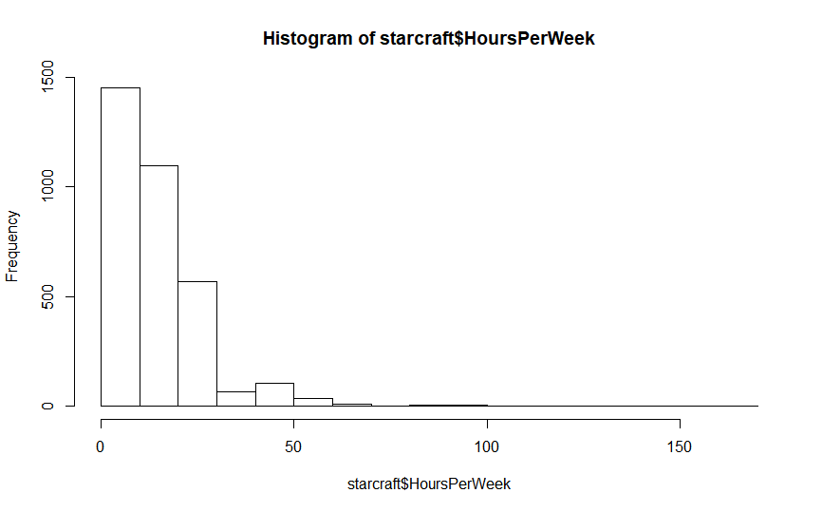
Histogram of the given data values - hist()
hist(Copy_of_starcraft$HoursPerWeek)

Slide 37
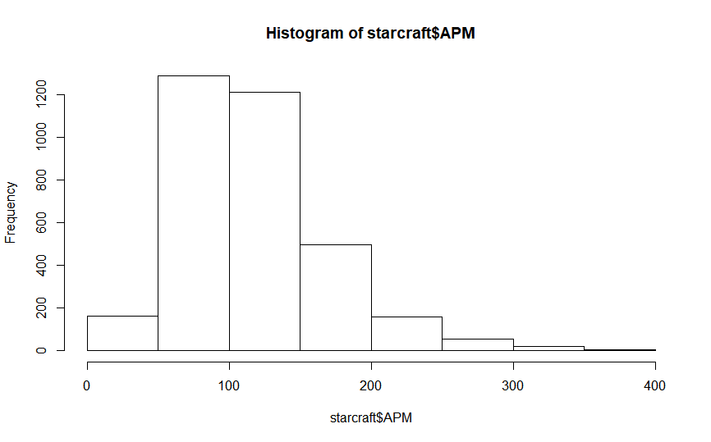
Histogram of the given data values - hist()
hist(Copy_of_starcraft$APM)

Slide 38
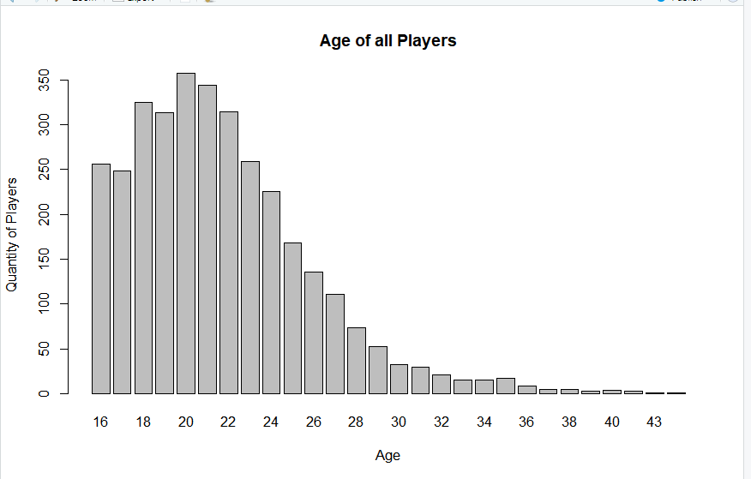
Bar plot with vertical or horizontal bars - barplot()
age <- table(Copy_of_starcraft$Age) //creates tabular results of categorical variables
barplot(age, main="Age of all Players", xlab="Age", ylab="Quantity of Players")
Notes:
table() creates tabular results of categorical variables

Slide 39
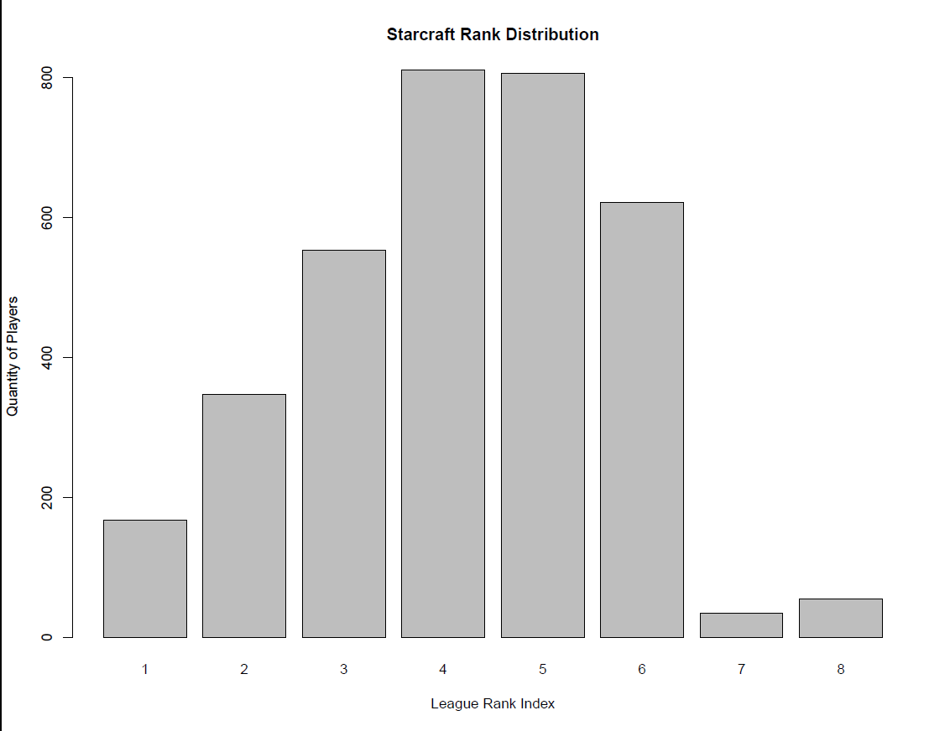
Bar plot with vertical or horizontal bars - barplot()
barplot(table(Copy_of_starcraft$LeagueIndex), main="Starcraft Rank Distribution", xlab="League Rank Index", ylab="Quantity of Players")

Slide 40
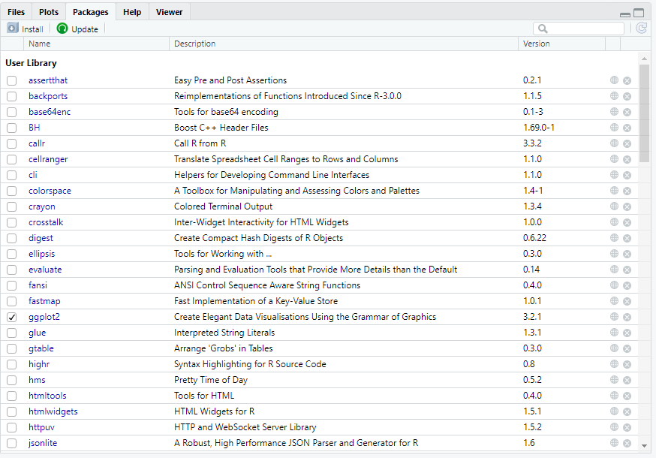
Installing Packages
We are going to plot 3D images but we need to install some packages to be able to do 3D plotting.
In the packages tab, click Install

Slide 41
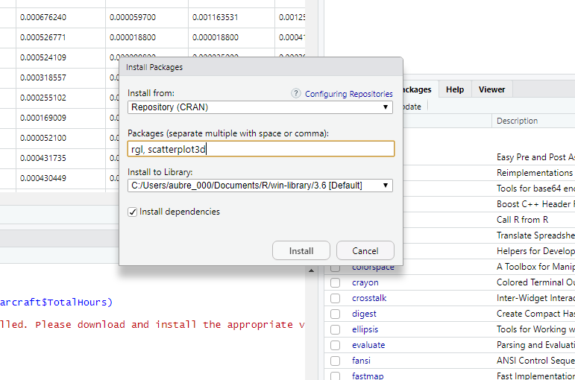
Installing Packages
Under Packages, put rgl insert a coma and put scatterplot3d

Slide 42
3D Graphs
After installing the packages open them up using the library() function, fill the parameter with the name of the packages you installed.
you can now use the functions to create 3D graphs
On the ‘a’ table, we can use the scatterplot3d() function to display the action latency by all players, including the hours per week by doing this: scatterplot3d(a$GameID, a$HoursPerWeek, a$ActionLatency, highlight.3d = T, angle = 75, scale.y = .5, xlab='Game ID', ylab = 'Hours Per Week', zlab = ‘Action Latency’)

Slide 43
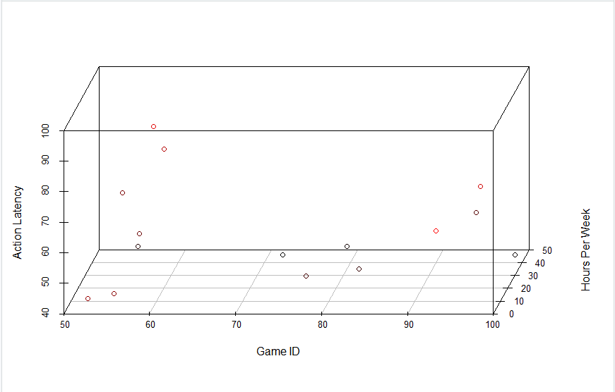

Slide 44
Installing More Packages
We’re going to make more fancy 3D graphs to show you just a tiny fraction of the sources that RStudio offers for designing graphs.
On the console add this command install.packages(“plot3D”), after the installation add this command, library(“plot3D”)
To get a visual representation of all the players APM and total hours played, use the scatter3D() function, for example: scatter3D(a$GameID, a$APM, a$TotalHours, phi = 0, bty = "g", type = "h", ticktype = "detailed", pch = 19, cex = 0.5)

Slide 45
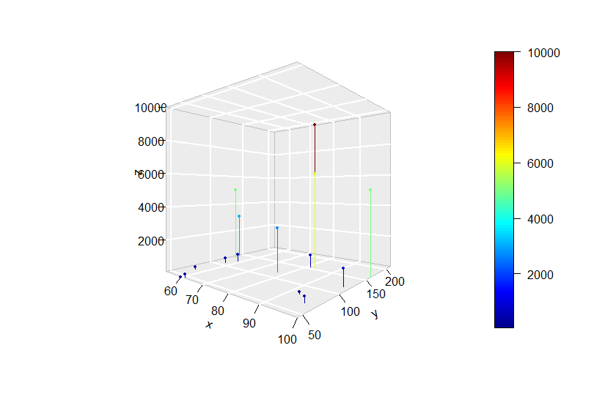

Slide 46
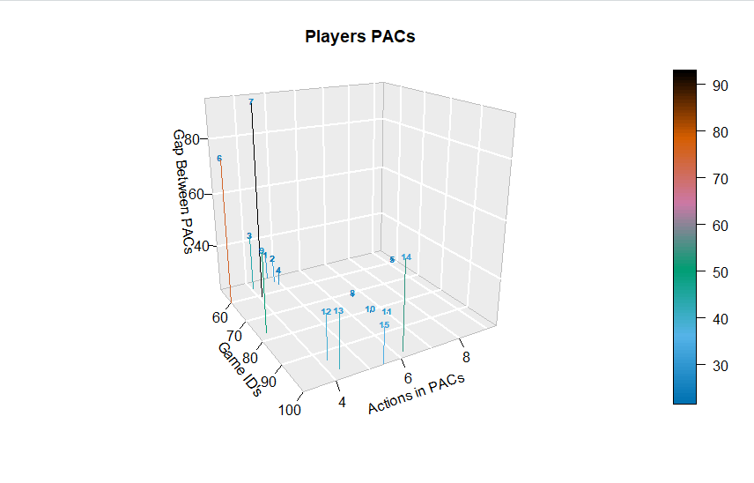
Plot 3-dimensional texts
text3D(a$GameID, a$ActionsInPAC, a$GapBetweenPACs,
labels = rownames(a),
col = gg.col(100), theta = 60, phi = 20,
xlab = "Game ID's", ylab = "Actions in PACs", zlab = "Gap Between PACs",
main = "Players PACs", cex = 0.6,
bty = "g", ticktype = "detailed", d = 2, adj = 0.5, font = 2)
scatter3D(a$GameID, a$ActionsInPAC, a$GapBetweenPACs - 1, col = gg.col(100),
type = "h", pch = ".", add = TRUE)

Slide 47
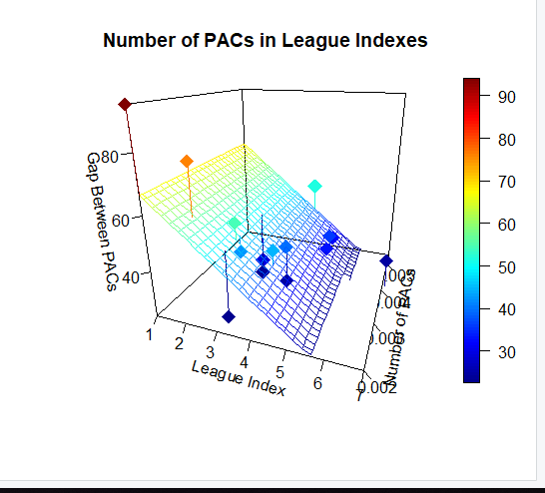
Regression Plane
Notes:
Regression is used to predict the value of a continuous variable Y based on one or more input predictor variables X. The aim is to establish a mathematical formula between the the response variable (Y) and the predictor variables (Xs).

